Slide 1
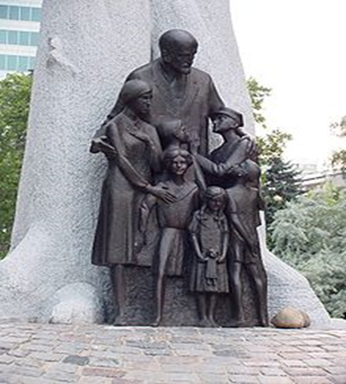
“Janusz Korczak’s concept of ‘Trust’ and its Significance to the pedagogical Challenges at urban schools environments”
Boaz Tsabar – Hebrew University, David Yellin college of education, Jerusalem.

Slide 2

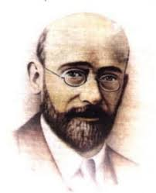
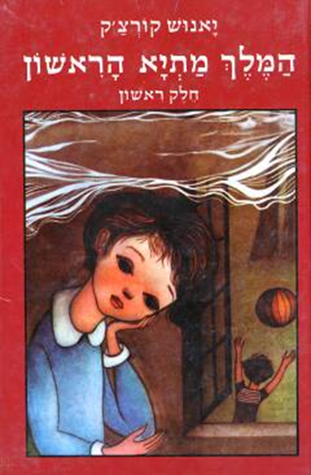
Biography :
Korczak was born in 1878 to a polish -Jewish family.
He was always involves in the world of children:
  As a pediatrician.
  Teacher trainer.
  Teen Jurist.
  Renowned children author.
  Founder and head principal of an orphanage home.

Slide 3
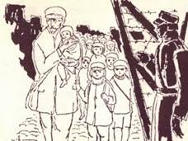
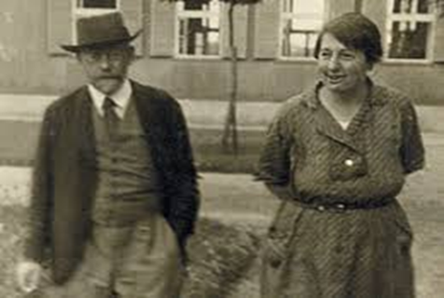
When Warsaw was concurred by Nazi Germany on September 1939, the Jewish institutions were put under tremendous pressure and were soon to be collapse.
Together with his faithful partner Stefania Wilczyńska (Stefa), tremendous effort was made to keep the orphanage active for the sake of the children.
At one point Korczak’s Polish friends offer him help with escaping from the Ghetto, and even prepare fake pass certification, but he refused to leave his children, and was sent with them, on the fifth of August 1942, to the death camps of Treblinka.

Slide 4
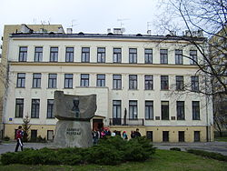
The orphanage home
The children assembled at the orphanage arrived from neighborhoods hurt by poverty, prostitution, alcohol and drug abuse.
They brought with them fears, anxieties and a strong feeling of distrust at the world that has failed them so brutally.

Slide 5
Trust Component
In such social setting a tremendous pedagogical intention was needed to re-habilitate relations of mutual trust (between the children and adult society, and among themselves).
Accordingly Korczak writes:
  “And the purpose of education: that the child may learn not to make noise, not to wear out shoes, to listen and do as he is told, not to criticize but to trust that everything is done solely for his own good.” (Korczak, 1914 p. 205).

Slide 6


Trust as a manifestation of human attachment
Human Attachment serves as a fundamental gateway to:
  The fulfilment of our humanity (Buber, 1973).
  Self-worth (Winnicott, 1960).
  Moral Ability to love others (Fromm 1970).
  Contribute creatively to the world (Freire1981).

Slide 7
The Educator – Agent of trust and relation
Korczak believed that it is the educator who is charged with the task of rebuilding the child’s trust in the world.
The Educator is the adult who is prepared to cope with the child difficulties and frustrations, and who demonstrates through his ongoing presence and labor a true commitment to the child’s welfare.
“the person – perhaps the only one – who was kind, who did not fail him, saw through him, understood, and remained kind. He – the teacher” (Korczak, 1967d p. 393).
“It is the job of educators to bring up, rear, guard under the wings of kindness and experience, in warmth and peace, shield against danger, keep in storage until they grow up, become strong enough for independent flight” (as cited in Cohen, 1972, p. 82).

Slide 8
How to build “Trust”?
This pedagogical approach finds expression in a strong desire to re-create a feeling of home and sense of belonging and meaning.
“Home” should be understood here in existential terms:
  as an inclusive, warm and accepting space that provides physical and spiritual security – a sense of identity, meaning and belonging, sense of worth.
  A secure place in which one can prepare himself for the challenges of the ‘outside’ world.
  How did Korczak achieved it (and what might we be able to learn from it )?

Slide 9

1. Respecting the Child’s Actual Life Experience
Against romanticism :
"A teacher starting out with the sweet illusion that he is entering a little world of pure, affectionate and open-hearted souls whose good will and confidence are easy to win will soon be disappointed. And instead of resenting those who have misled him and rebuking himself for having been taken for a sucker he will nurse a grudge against the children for shattering his faith". (p. 246 [Section 69])
Respecting the child actual life and efforts (personal objects) :
“A tiny shell is a dream of a trip to the seacoast. A small screw and a few pieces of thin wire are an airplane and proud dreams of flying one. The eye of a doll, broken a long time ago, is the sole reminder of a long-lost love. You will also find the mother’s photograph and two pennies received from a grandfather now dead, and wrapped in pink tissue”.

Slide 10
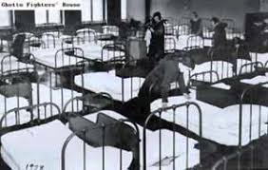
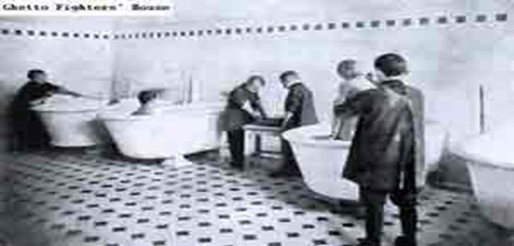
2. Regularity as a Gateway to Trust
Establishing a safe and protected environment by creating a sense of routine and structure in the children's life to counter-balance the effects of the chaos in the children’s lives before.
All areas of the children’s lives were strictly organized: food, sleep, housekeeping, rising in the morning, community life.

Slide 11
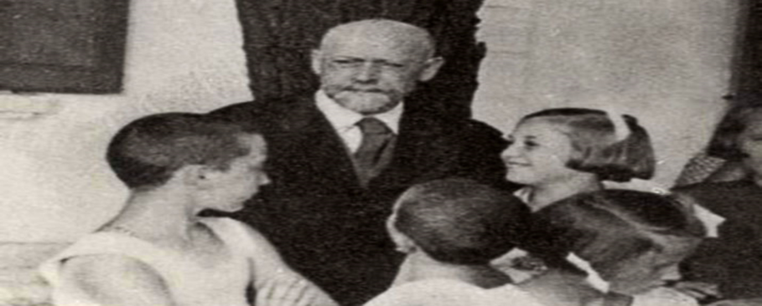
Yet…
Korczak understood that formal, clinical arrangements are never sufficient.
Accordingly, he actively took part himself in all work of daily life at the orphanage – cleaning and tidying the rooms, peeling potatoes for meals, bathing the small children before bedtime.
It was precisely in these simple moments that Korczak could talk with the children, look them in the eye, directly and powerfully convey his presence.

Slide 12
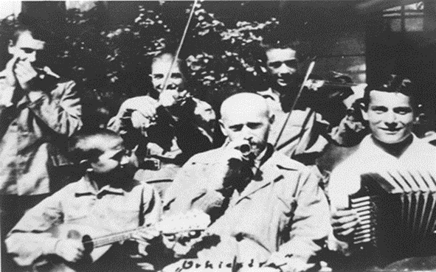
3. The Right to Play, Experiment and Err
In order to restored the child’s faith in the world he must feel confident that he can experiment and make mistakes without fatal-negative consequences occurring him.
“An atmosphere of broad tolerance for a joke, mischief, spitefulness, falsehood and naïve sin must absolutely prevail. There is no room here for iron duty, stony seriousness, dire necessity and absolute conviction. Every time I echoed the monastery bell, I invariably went astray” (p. 241 [Section 61]).

Slide 13

The principle of ‘forgiveness’
The reality of the children’s lives prior to coming to the orphanage was one in which there was little room for error. Society’s patience for its ‘forsaken children’ tends to be short.
Restoring the children’s trust in the world required constructing a safe, accepting and forgiving space in which they could make mistakes and do wrong without being stigmatized.
“Most important then, is for the educator to be able To forgive: in every case wholly and completely. To understand everything is to forgive everything. The teacher has to growl, grumble, shout, scold, threaten, punish; but within and for himself he must judge every offense, breach, fault kindly”. (1967, p. 393)

Slide 14
Children have a right to be children
The ‘Right for moratorium’ serves as an expression of commitment and love toward the child.
“Children should be assured the freedom necessary for harmonious development of all their mental powers, allowed fully to expand their latent powers, be brought up with respect for virtue, goodness, beauty and freedom… Be naïve – go on and try! […] all are waiting… the state, the church and the future employer. They demand, wait and watch. The state demands patriotism, the church – faith, the employer – honesty, and all demand mediocrity and submission”. (Korczak, 1914/1967b, p. 205)

Slide 15
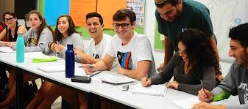
Toward conclusion : two possible question for discussion:
If we accept trust to be a fundamental pedagogical factor:
What are the current (economical, pedagogical, historical and cultural) forces that are harming their ability to create relations of trust with their students?
How can we translate the notion of “trust” into our daily pedagogical routine at school?
Thank you for listening! ☺

