Slide 1
ETEN – September-meeting
20-22 September 2023
Kristianstad University Sweden
Notes:
Welcome to Kristianstad University. A high-quality university with a big heart.
(Till dig som presenterar: Du kan ändra rubriken så att den passar till din presentation. Titta igenom innehållet i presentationen och ändra ordning på, lägg till eller plocka bort/dölj innehåll så att presentationen passar i det sammanhang och för den målgrupp som du möter).

Slide 2
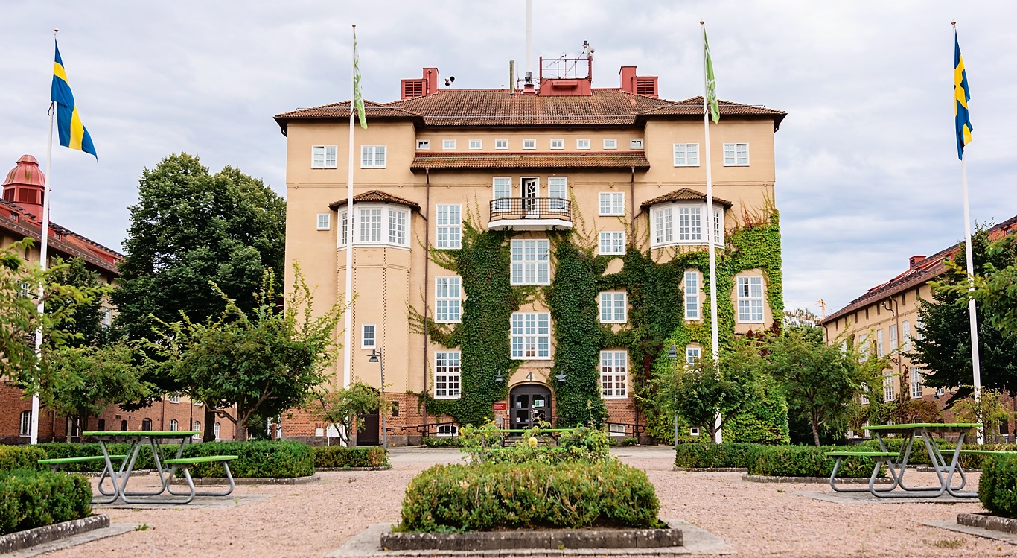
Credits: Sjunnesson Photograpy
Notes:
We focus on integrating theory and practice and throughout your studies you will be preparing for working life. Kristianstad University educates for the future and attaches great importance to preparing you for your professional career.
Credits: Sjunnesson Photograpy.

Slide 3
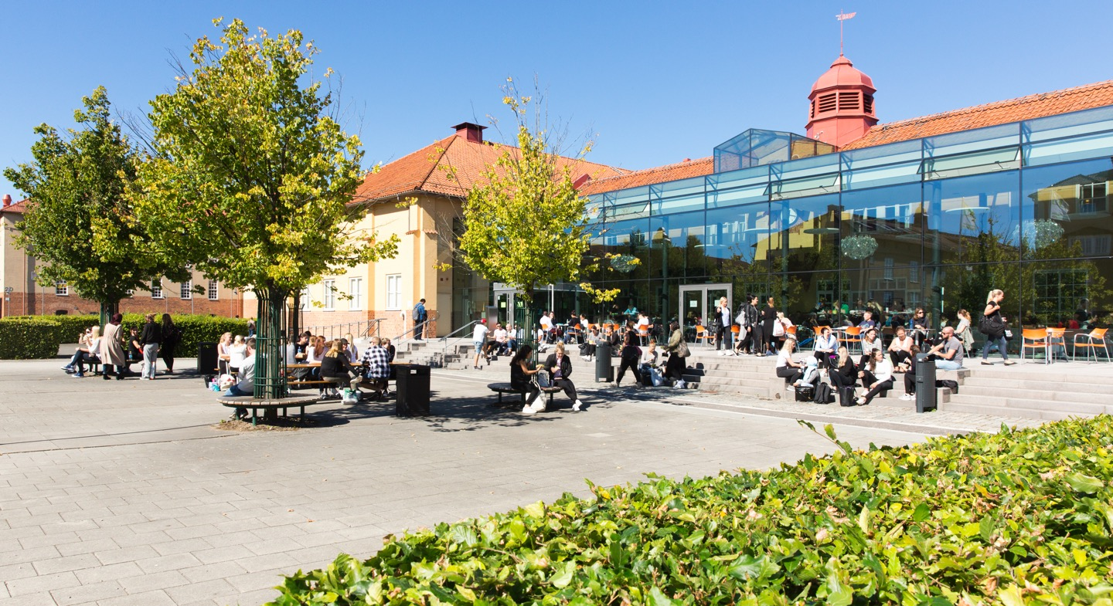
Credits: Lars Strandberg
Notes:
At the university campus you can find everything you need within a short walking distance. There is a library, a restaurant, a café, the student union and student housing all in one place. In the middle of the campus you will find a spacious library with study rooms, computer rooms and open spaces where you can read or relax.
Credits: Lars Strandberg.

Slide 4
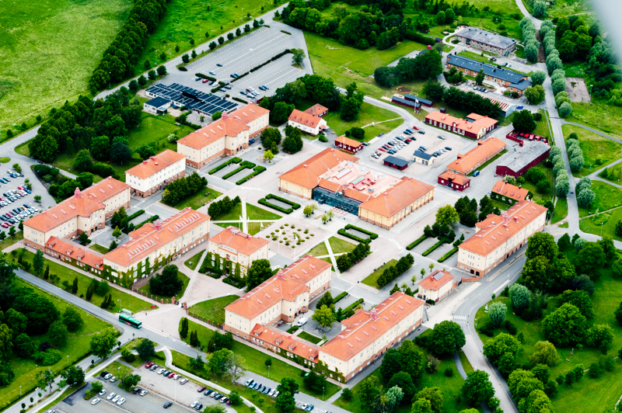
Credits: Jens Christian
Notes:
Our library has plenty of study areas and gives access to all the literature on students reading list. Library staff offers support in information retrieval, academic writing and mathematics.
Credits: Lars Strandberg.

Slide 5
Areas of education
Health Science
Educational Sciences
Business and Human Resources
Social Sciences
Culinary Arts and Food Science
Computer Sciences
Natural and Environmental Sciences
Engineering
Notes:
Kristianstad University offers a wide range of programmes and courses, all of which are distinguished by science, research and high quality education. We provide students with a unique set of academic and professional skills, preparing them for a working life in areas such as education, health, business and the environment. (All courses and programmes offered in English for international students are also available for Swedish students.)

Slide 6

72%
WOMEN
50
PROGRAMMES
14 000
STUDENTS
28%
MEN
250
COURSES
Credits: Sjunnesson Photography
Notes:
These figures apply to the university as a whole.
Credits: Sjunnesson Photography.

Slide 7
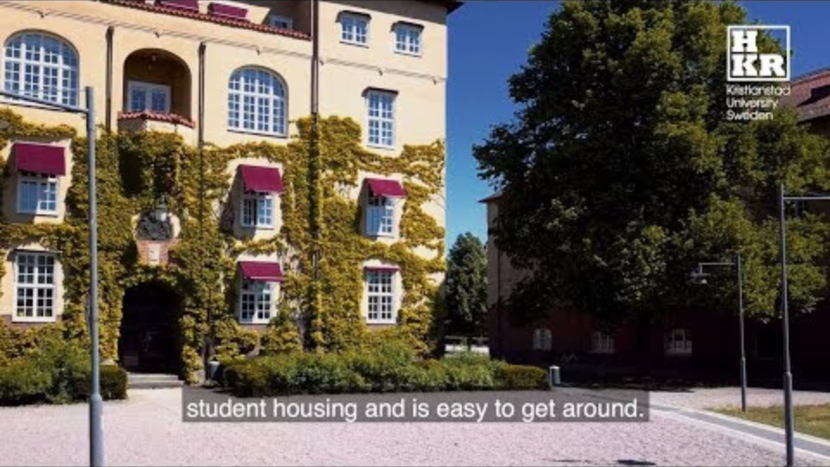
Notes:
Kristianstad University is a high-quality university with a big heart. Welcome!
Vill du lägga till en egen film? Gå till fliken Infoga och tryck på Video. Du har ­möjlighet att välja att infoga en video från fil (Film från fil) eller från en webbplats (Onlinefilm). Väljer du Onlinefilm så klipper du in en länk för den film du vill visa, t ex en länk från Youtube.

Slide 8


Slide 9
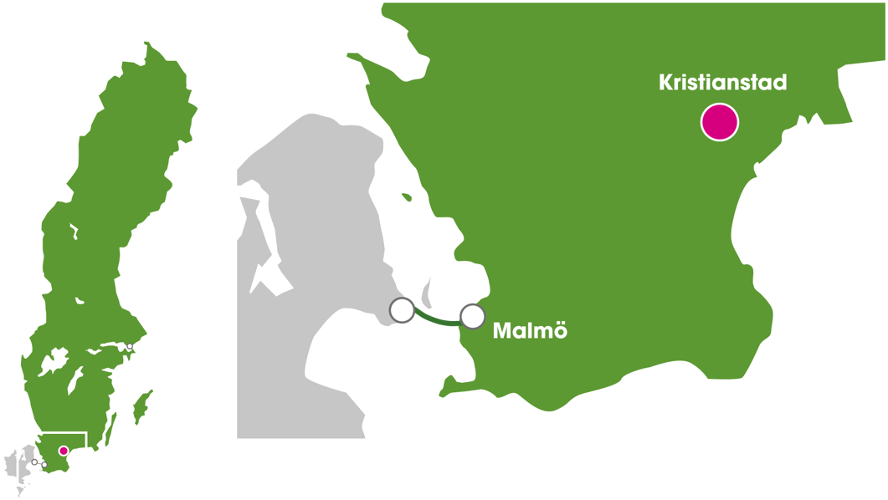
Notes:
Together with the Danish Zealand, Skåne is part of the Greater Copenhagen – one of the fastest expanding areas in northern Europe. From Kristianstad, you can easily get to Copenhagen, and from here travel further to the rest of Europe and all over the world.

Slide 10
How to get to Kristianstad
Train/flight to Copenhagen
Train from Copenhagen to Kristianstad, 1,5 hour, twice an hour
Bus 4 from Kristianstad → University 10 min (2-3 times an hour)

Slide 11
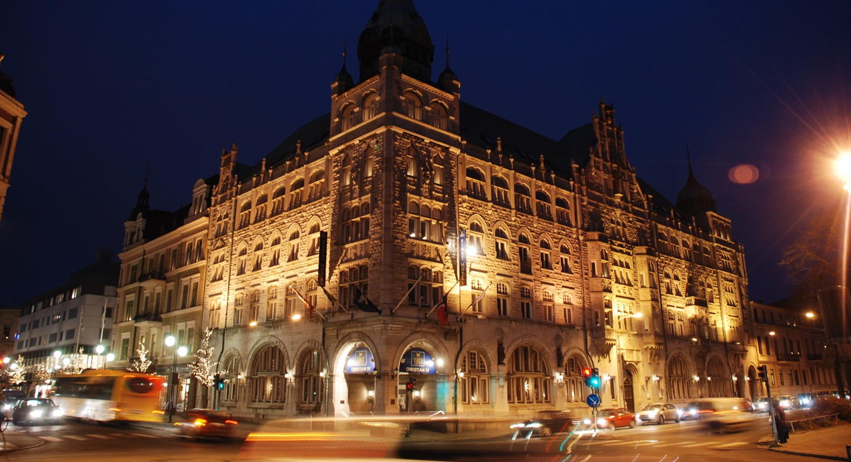
First Hotel Christian IV
Quality Hotel Grand
Booking code: HKR V38
(June 1st)
Budget
Hotell Kong Christian
Åhus
Åhus Gästgiveri
Åhus Seaside
Credits: Kristianstads kommun/Claes Sandén
Notes:
City centre. The picture shows one of many beautiful and historic buildings in the town of Kristianstad.
Credits: Kristianstad kommun/Claes Sandén.

Slide 12
Program
Wednesday 20 September
  Welcome to Kristianstad University
  Reception
Thursday 21 September
  ETEN-meeting
  Gala Dinner with dance
Friday 22 September
  ETEN-meeting (morning)
  Lunch
  Social activity (volontarily)

Slide 13
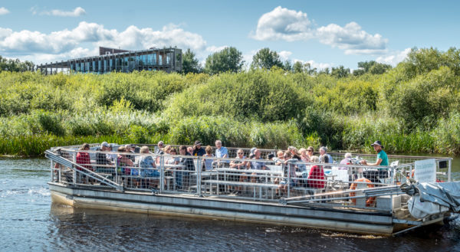
The Big Safari Boat
Credits: Kristianstads kommun/Mattias Roos
Notes:
Thanks to the Right of Public Access everyone is allowed to move freely through the Swedish countryside. There are many opportunities to enjoy outdoor activities such as canoeing, trekking and climbing.
Credits: Kristianstad kommun/Mattias Roos.

Slide 14
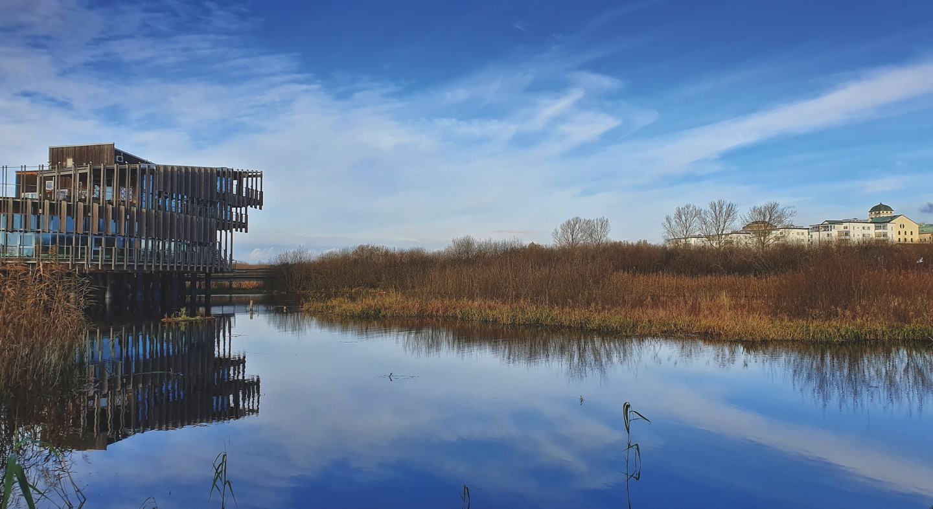
Credits: Kristianstads kommun/Claes Sandén
Notes:
The town is renowned for its Vattenriket – the wetlands and grasslands designated as a biosphere reserve by UNESCO. Naturum is a nature centre situated close to the town centre and provides a number of displays illustrating the great biodiversity of the region.
Credits: Kristianstad kommun/Claes Sandén.

Slide 15
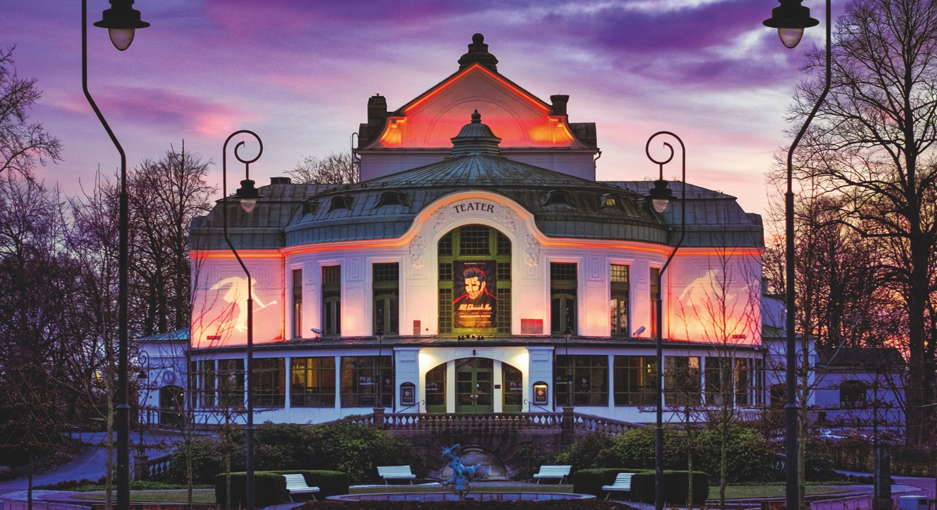
Credits: Joel Andersson
Notes:
Another place of culture and entertainment is Kristianstad Theater - the jewel of Kristianstad Tivoli Park, situated in the center of town. Watch theater performances and musical productions in one of the oldest theatres in Sweden.
Credits: Joel Andersson.

Slide 16
Registration
Opens …..soon
Registration fee: EUR 213,-
Registration fee + sociail activity: EUR 240,-
Link
https://forms.gle/KABcGB4FcPwuMh1P7
Before 4 September

Slide 17
International week 18-21 Sept
The Teaching Profession
Monday 18 September
Opening ceremony -Welcome reception
Tuesday 19 September
Campus-tour
Individual program for international guests with seminars for students
KU researcher presentations and discussion
Networking and Dinner
Wednesday 20 September
Individual program for international guests with seminars for students
Seminars/Workshops with KU staff and international guests
Campus-tour
https://www.hkr.se/internationalweek2023

Slide 18
Contact: pia.thornberg@hkr.se

Slide 19


