Slide 1
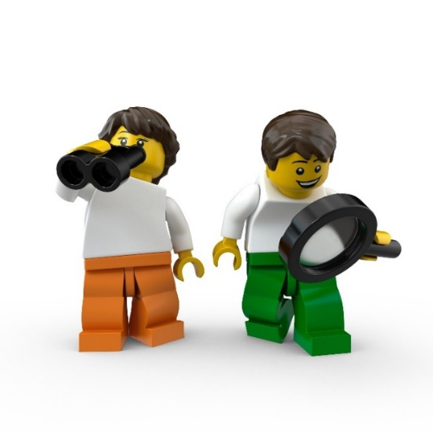
Storytelling as a learning strategy for reflection during internships
E.T.E.N. Nürnberg - TIG ‘Reflective Practice and Teaching for Thinking’
14 april 2023
Eve Baert

Slide 2
Reflection during internship
Students reflect on their own learning experiences during their internship in a primary school. They will discover what they have learned and what their strengths and weaknesses are. After they think about that, they discuss their own development in small groups of 5/6 people. They go deeper into the own actions to learn from them with the aim of increasing their professionalism.
They think in group about goals, opportunities, solutions to solve difficult or critical situations.

Slide 3
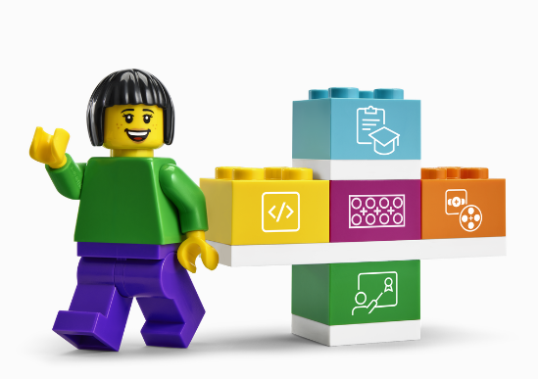
Why storytelling?
During reflection moments, students often find it difficult to talk about their own actions. Students' experiences during their internships are often complex. They sometimes find it difficult to make themselves vulnerable. They don't think deeply or talk impersonally.
Lego - StoryTales can be used as a creative tool to encourage and support students' reflection during their internships.

Slide 4
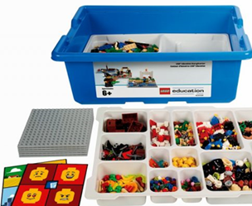
With lego, they learn to transform (difficult) situations into images to further communicate with the other students. In this process they develop their effective communication and storytelling skills and they dare to discuss difficulties more often.

Slide 5
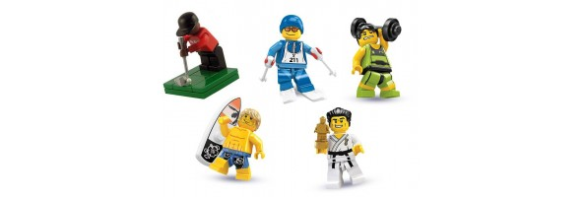
Let’s do – warming up
You have 5' to create a landscape in which you emphasize an aspect of your personality / a specific trait that your person describes in your daily life. There are no wrong answers!

Slide 6

Let’s meet!!

Slide 7
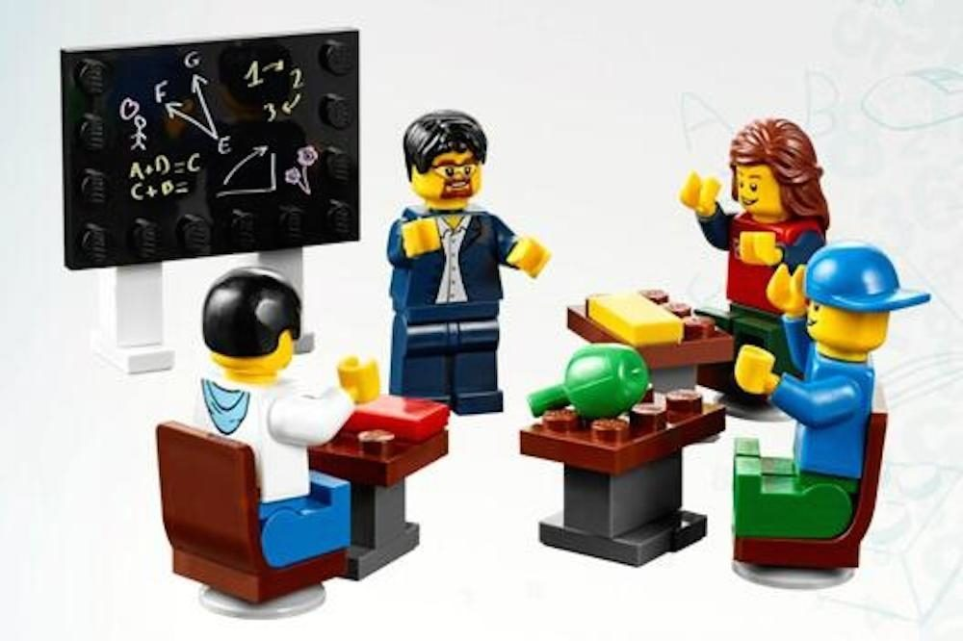
Let’s take the next step
Which teacher trainer do you want to be? You can create a landscape in which you emphasize an important trait that makes you the teacher you want to be. There are no wrong answers!

Slide 8
Let’s meet!!

Slide 9
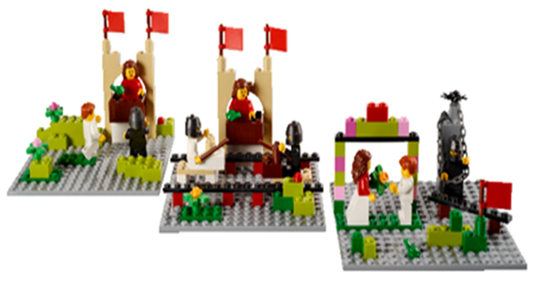
And the next step is …
Brainstorm together about the impact of our TIG "Reflective Practice and Teaching for Thinking," the strengths of international peer exchange, and the transfer after the congress to the own job.
Create a setup with the Lego material. Turn your thoughts into images, use metaphors.
Think about how you will articulate the image (the metaphor).
Shall we try? Let’s build!
And after that … let’s talk!

Slide 10

Hope you enjoyed the workshop!

Slide 11
Lego Lab

Slide 12
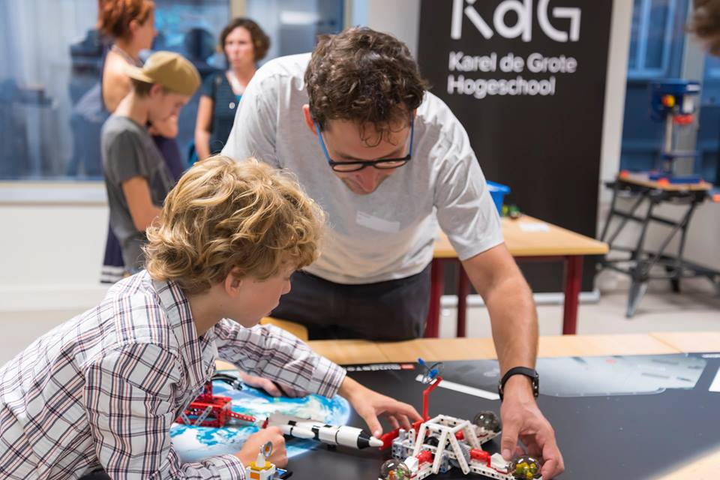
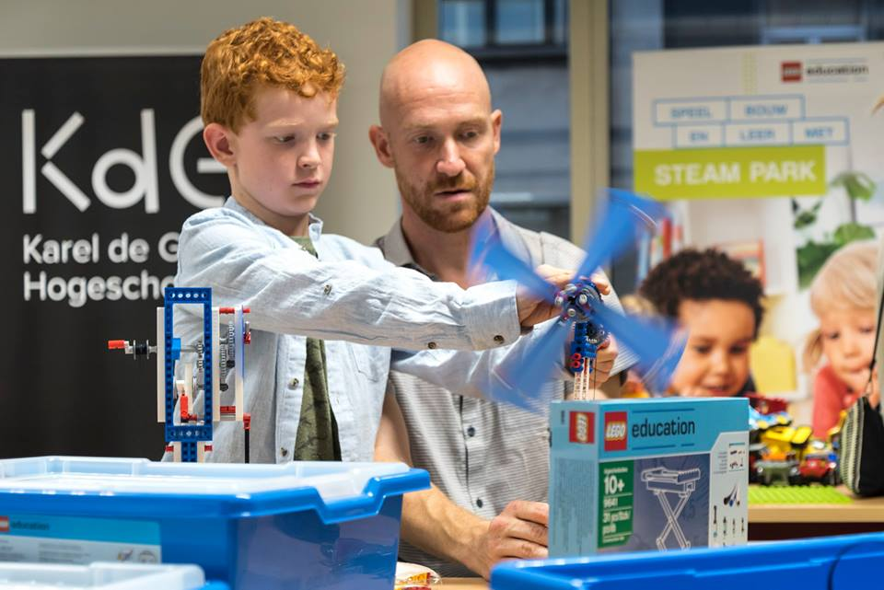
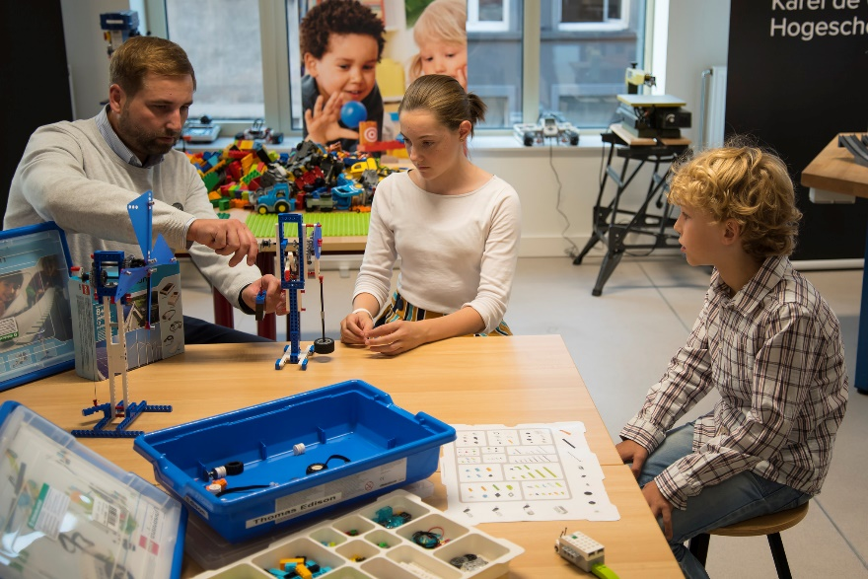
Lego Education Lab

