Slide 1

Students’ reflections
Using video tools

Slide 2
Eksamples of videos by students
 | Opløsning -1080 | Opløsning - 720
Spisesituationen | https://video.kp.dk/media/Spisesituationen/0_wi0g07fj | https://video.kp.dk/media/Spisesituationen+-+720/0_jp0sqb1y
Samlingen | https://video.kp.dk/media/Samlingen/0_ijncqhs7 | https://video.kp.dk/media/Samlingen+720/0_c4s4ukz3
Tegneprojektet | https://video.kp.dk/media/Tegneprojektet/0_2va4vpzi | https://video.kp.dk/media/Tegneprojektet+720/0_zsswe18k
Pomfritprojekt | https://video.kp.dk/media/Pomfritprojekt/0_bcnzw3fy | https://video.kp.dk/media/Pomfritprojekt+720/0_3yc63rlx
Eftermiddagsmad | https://video.kp.dk/media/Eftermiddagsmad/0_fzhr7w5d | https://video.kp.dk/media/Eftermiddagsmad+720/0_pa80sx30
Garderoben | https://video.kp.dk/media/Garderoben.m4v/0_uqegnvj5 | https://video.kp.dk/media/Garderoben+720/0_zqk5lup4
We made a collection of videos made by students for educational use
The videos are not perfect in terms of technical or professional focus
Video recordings like these of very ordinary and everyday situations in professional practice are very useful to exercise your reflective ‘muscles’☺.

Slide 3
when seeing the two films?
Quick task with the person next to you
What is the first thing that comes to your mind
What is the second thing that comes to your mind?
Why?

Slide 4
Language note
The term ‘pedagogue’ in Denmark refers to a specific profession. By taking a degree in social education, you may become a ‘pedagogue’, which covers work with “development and care assignments within the following areas: children and young people (including working in day nurseries, day-care centres, pre-school classes, recreation centres/school-based leisure time facilities, after school clubs, 24-hour service institutions), institutions for children, young people and adults with reduced psychological or physical capacities, adults with social problems (homelessness, substance abuse, mental disorders), family institutions, and child and youth psychiatric hospitals. Additionally, the education provides qualifications for working in the field of crime prevention in, for example, neighbourhoods as well as working within the Prison and Probation Service.” Quote from Ministry of Higher Education and Science http://ufm.dk/en/education-and-institutions/higher-education/university-colleges/university-college-educations/bachelor-in-social-education .

Slide 5
When students see themself act in pedagogical situations and reflect on with a professor, counselor or co-student it helps them develop their pedagogical competencies
Since video recordings can be viewed again and again students can focus on and train attention on specific aspects af the pedagocical work in their own pace
The project ‘Videobased professional reflection’ was started in 2021 after a few years of developing the ideas and technique.
Every semester we’re introducing more professors to video reflection
Video reflection can be used for in-house teaching and especially during internships and for i-service professionals.

Slide 6
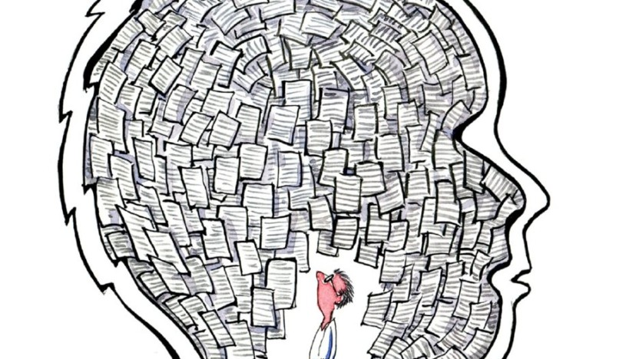

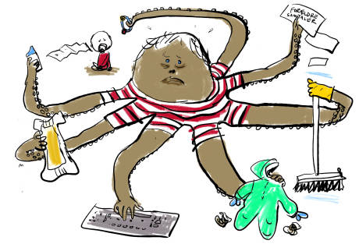
Why this project?
https://voresvirkelighed.dk/?p=2985
http://lyngbyfrikirke.dk/blog/det-du-taenker-og-tror-afspejles-i-det-du-siger
https://overbevisende.dk/fjern-deres-frihed-hvis-du-vil-have-dem-til-at-handle/
Notes:
Kun deres/vores (efter)reationaliserede og af os udvalgte foki
De studerendes egne fortolkninger – hvad er det altså, vi kan forholde os til? Deres forestillinger om deres praksis
Der sker så meget mere end det, de/vi selv får øje på

Slide 7
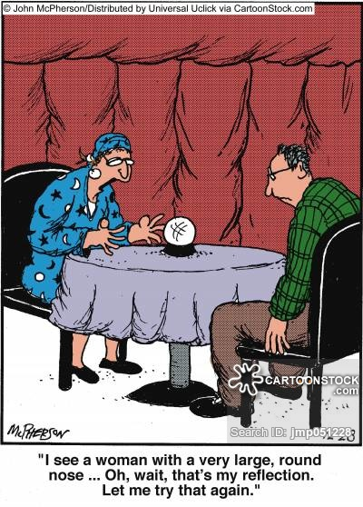

We do not have acces to students’ practice….
Only their own descriptions and reflections

Slide 8

Foucs on practice
It affects one to see oneself in a professional practice
An outside perspective to oneself
Ou-of-the-body experience
Other-view (‘how others percieve me’)
It affects you both personally and professionally.
Just seeing yourself in professional practice triggers reflections and thoughts

Slide 9
Professional knowledge
From seeing yourself to a professional reflective practice
The social environment
You put yourself in a very vulnarable and precarious situation
A ‘safe space’ between/for students/councelors/professors
Technical
It is very intuitive but takes practice
Lack of technical proficiency is a hindernes
Technical profienciency is a ‘enhancer’
Different arenas for students (and everyone working with video self-reflection)

Slide 10
Progression of level of reflection in students
Students (and everyone else) seem to move through different stages of reflection when working with their own videos
1. OOOMMMGGG, Do I really sound like that?
I see myself
Focus on appearance and looks
An outside-view with and by oneself
2. Look what I did!
Showing it to others (counselor and fellow students)
Focus on actions and possible improvements
An outside view of self as by others
3. Pedagogical/professional expertice and knowledge
What happens on the film is an expression of a certain professional expertice
How can we understand it and reflect on it together.
A other view by me and others. Not me, but ‘just’ a professional
Evaluating/critical commenting -------→ refelction--------→ analysis

Slide 11
Progression of level of reflection in students
Students (and everyone else) seem to move through different stages of reflection when working with their own videos
1. OOOMMMGGG, Do I really sound like that?
I see myself
Focus on appearance and looks
An outside-view with and by oneself
2. Look what I did!
Showing it to others (counselor and fellow students)
Focus on actions and possible improvements
An outside view of self as by others
3. Pedagogical/professional expertice and knowledge
What happens on the film is an expression of a certain professional expertice
How can we understand it and reflect on it together.
A other view by me and others. Not me, but ‘just’ a professional

Slide 12
What are we using them for
Exams
  Students have to bring documentation other than a written product
In class
  Sharing is caring – seeing other students’ films is very engaging and they start refelcting on them self/own practice
  A very honest material – and not written, interpretated
Internships
  Professional development with colleagues/councelors
  Seeing them for themselves

Slide 13

Value for in-service councelors and schools
Counceling:
  Students and councelors have a different and very specific material for their talks.
  In-service councelors have acces to view and re-view a small part of practice together with the student
  If the councelor dares ‘go first’ He/she also have the opportunity to view his/her own professional actions – And those who dare simply love it
School :
  An ‘outside-view’ on the practices/pedagogies
    To see what you don’t ususally see. De-naturalizing or discovering the obvious.
  Sharing/ making common practical knowledge (if the student is willing to share videos)

Slide 14
What I didn’t tell you
What is reflection? How we prepare students
Gdpr – setup is extencive
We’re changing the platform – so no point in showing too much

Slide 15


