Slide 1



Nord University
ETEN presentation
Marina Prilutskaya

Slide 2
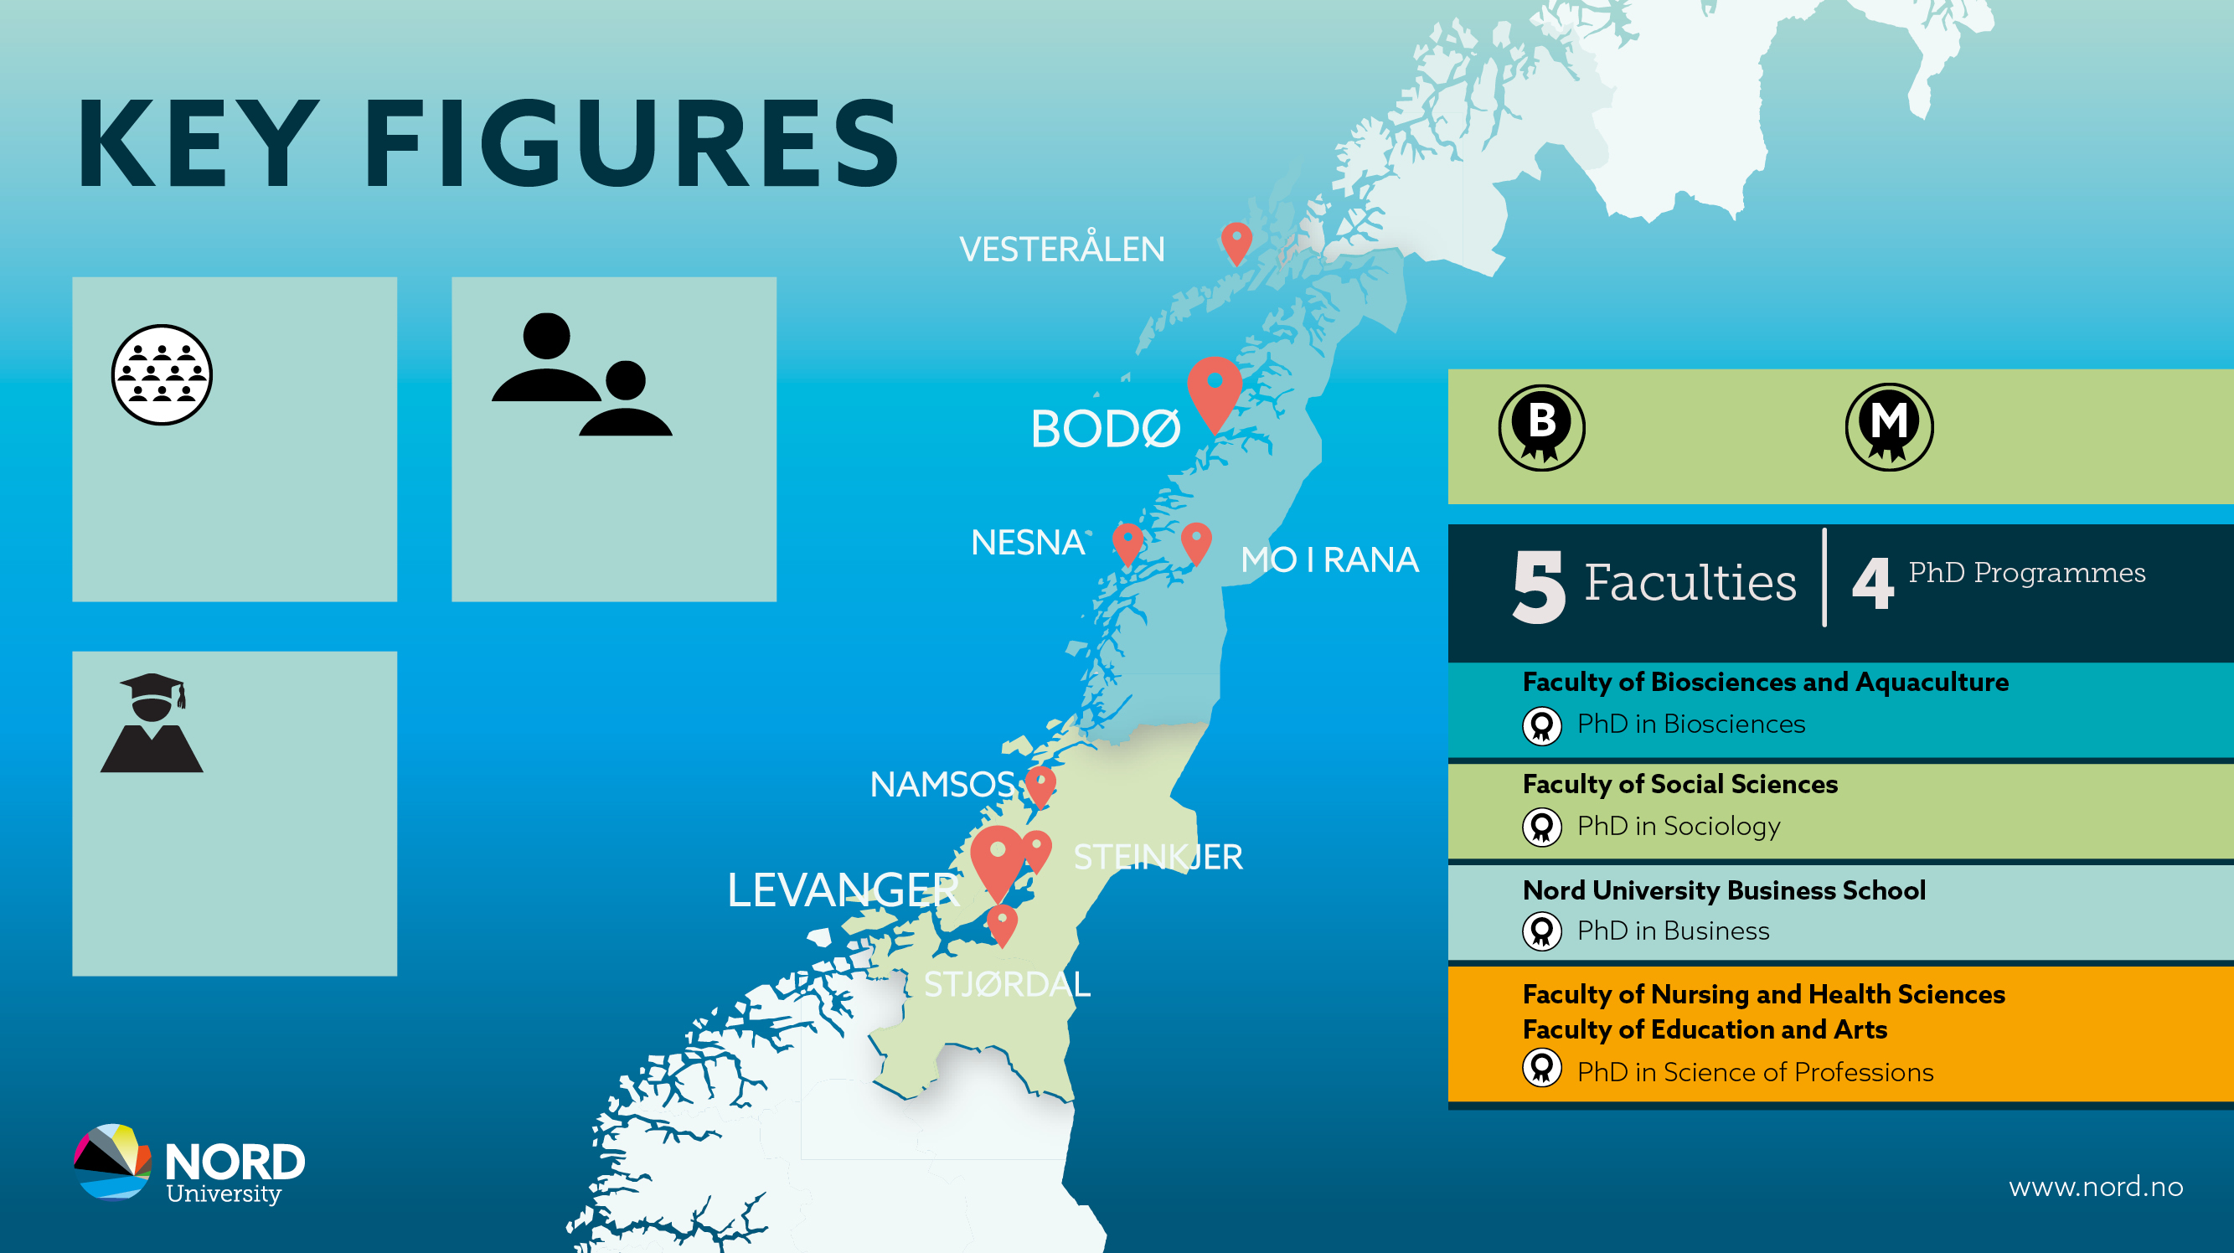
47
Bachelor´s Programmes
35
Master´s Programmes
11.300
Students
1.450
Employees
2.080
Candidates

Slide 3
NORD UNIVERSITY
Through research, education and social engagement, Nord University contributes to the creation of a sustainable future.
In cooperation with society, business and industry in Northern and Central Norway, our 11,500 students and 1,450 staff promote innovative solutions and knowledge-based practice, both locally and internationally.
Nord University has four strategic focus areas: blue and green growth, sustainable innovation and entrepreneurship, societal security, and health, welfare and education.
https://vimeo.com/1019712386/34a3125d6f

Slide 4

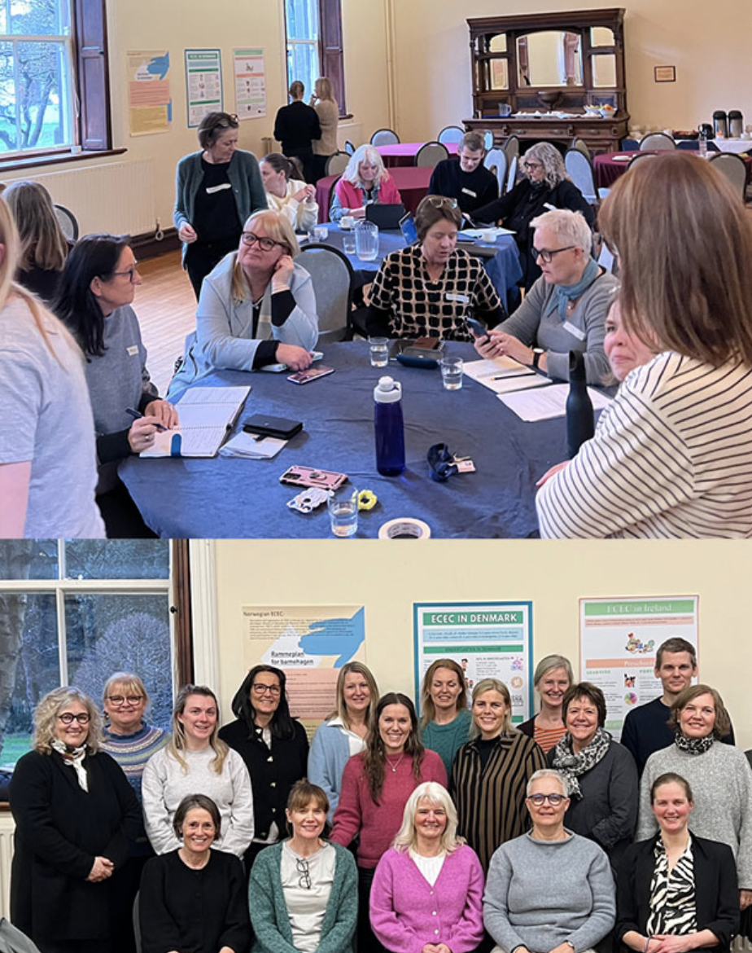
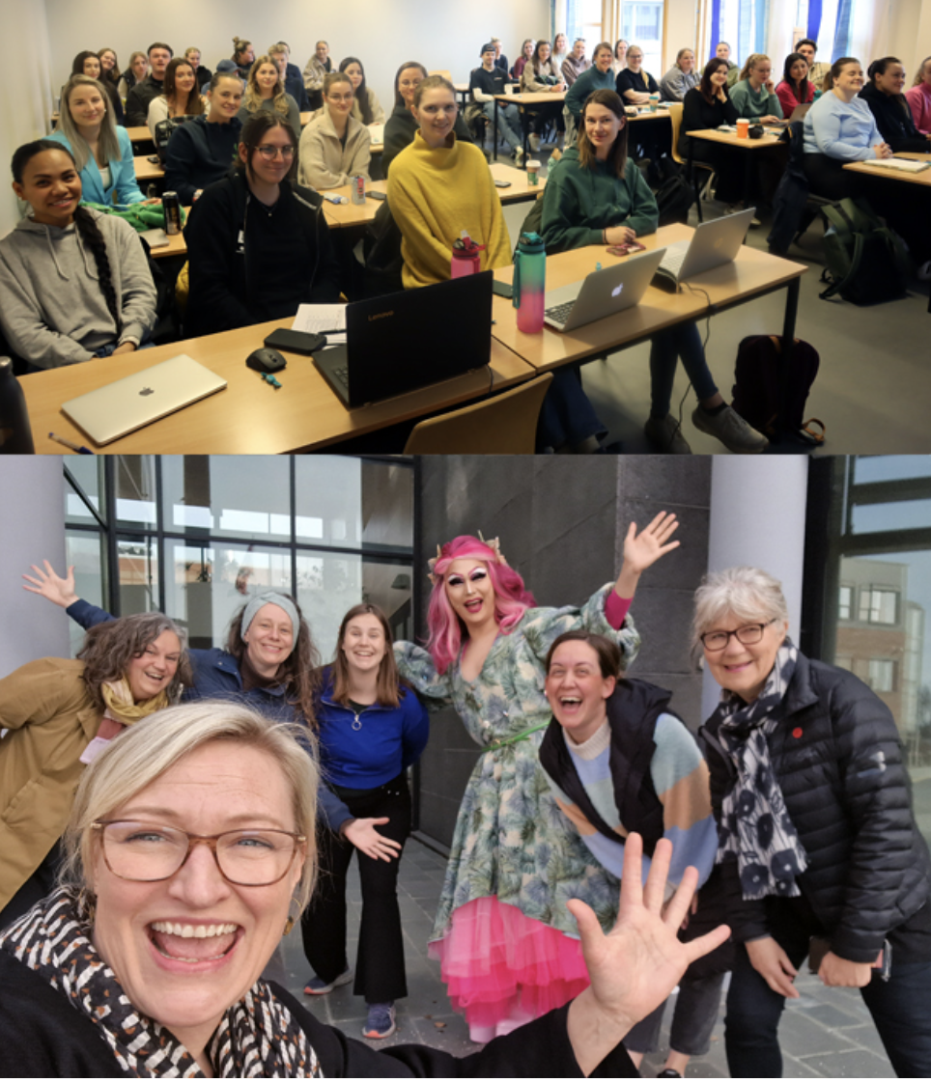
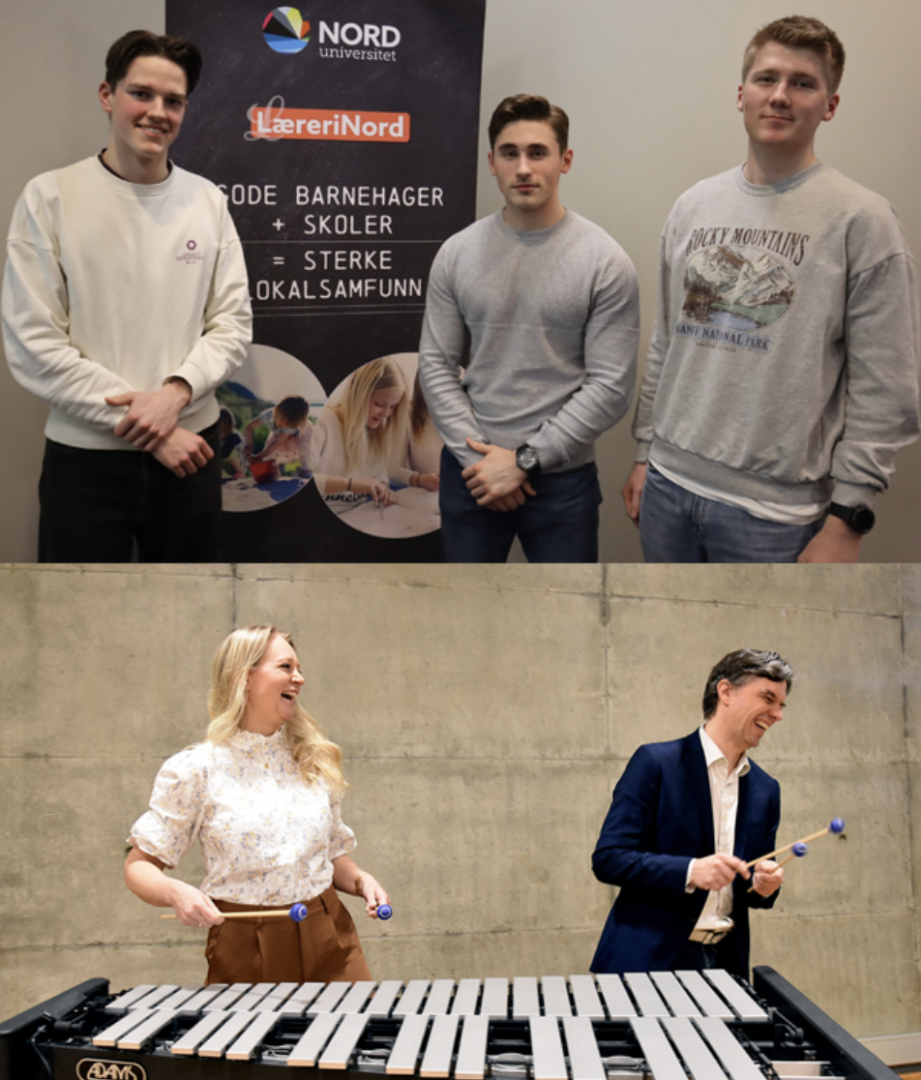
Faculty for Education, Arts and Culture (FLU)

Slide 5

Notes:
Aim of th faculty is to attend to and take care of education, art and culture or an ever changing world.
We are located at three of Nords campuses – Bodø, Levanger, and Nesna
Approximatly 350 staff
5000 students

Slide 6
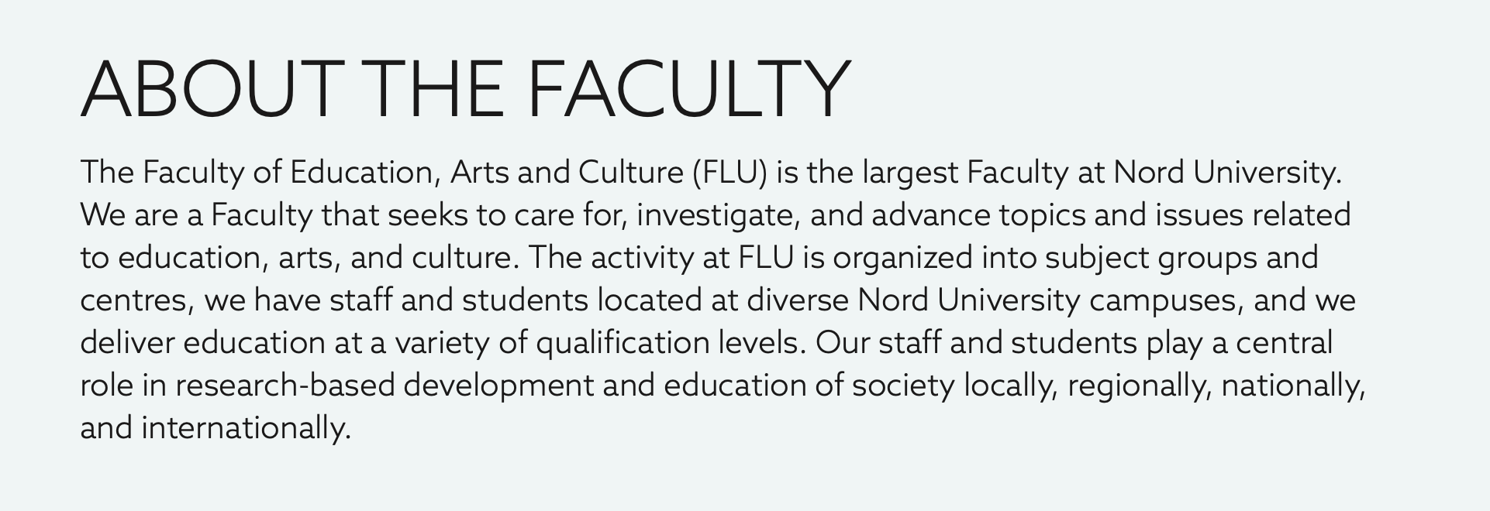
Notes:
We are the largest faculty, and it is also important to note that while there are long histories within the faculty, we have only existed in the form of this particular faculty after a merger in 2018, so we are ‘young’ in that regard.
Our focus is teacher education - kindergarten and then also primary and secondary education. We also focus on delivering specialised programmes in physical education, music education, theatre, and so on.
The Faculty of Education and Arts educates tomorrow’s teachers from preschool to upper secondary school, and within sports and the fine arts. Our candidates play a vital role in the knowledge-based development of society. The Faculty aims to contribute to the further development of the preschool and school system at all levels, and our research emphasizes the teaching profession and professional teaching practices. The Faculty offers a doctoral program (PhD) in the study of professional praxis.
The Faculty of Education and Arts has 3500 students, and 350 academic faculty and administrative staff members in Levanger, Bodø and Nesna. ​

Slide 7
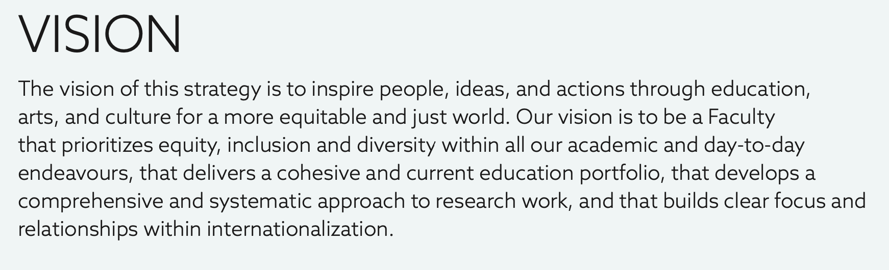
How we see ourselves as a faculty…
Small but energetic
Delivering high quality education and research
Local connections and global networks
Active and in step with the times
Notes:
How we see ourselves as a faculty…
Small but powerful
Young, fresh and relevant
High quality education and research
Local connection and global network
Active and in step with the times - not afraid to be bold and brave

Slide 8


Equity, diversity, inclusion
Education
Research
Internationalization
Notes:
Special responsibility for South and Lule Sami languages and cultures

Slide 9
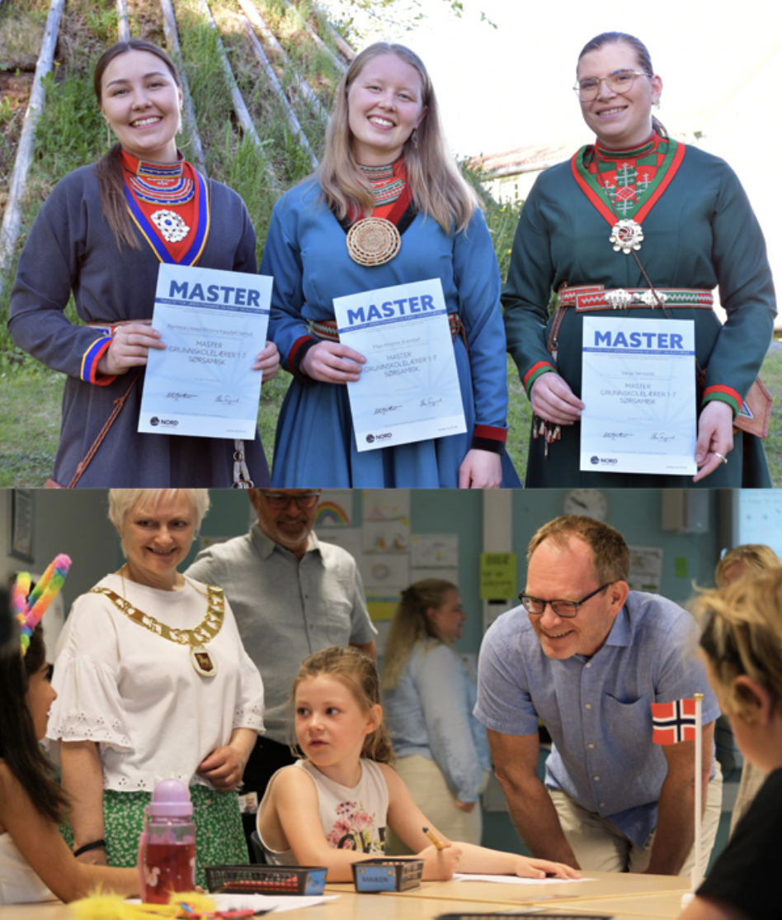
The future of our education portfolio…
A more streamlined and more focused education portfolio
Further flexible programmes
A stronger and more developed online and gathering based education
Lifelong education offerings - micro-courses and more "design / build your own degrees"
Further international offers over time
Notes:
We'll probably have fewer and more focused programmes.
We'll have a more flexible programme - we'll alternate between digital, face-to-face and campus teaching.
A stronger and more developed online education
EVU offerings - micro-courses and more "design your own degree" (if and when regulations allow).
MUCH more international offerings - from courses to degrees.
We offer some very unique education programmes such as South and Lule Sami teacher education – it is a small education, but one that we hope to slowly and steadily hope to grow as it is extremely significant for our communities an for the support and development of for example the Sami languages which are at various stages of at risk or endangered.

Slide 10
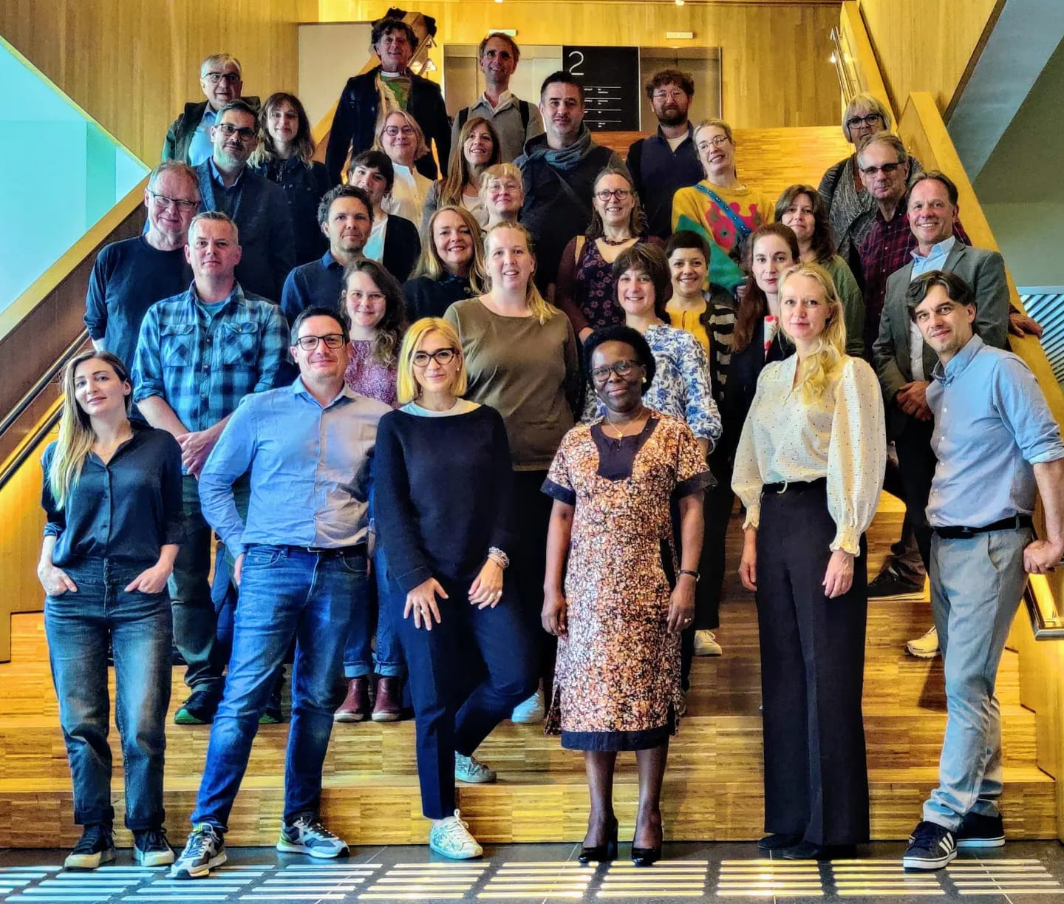
The future of our research portfolio…
Continue to build our external research funding
Build on sucesses in Horizon Europe
Advance thematic areas such as Sámi and indigenous topics, small and rural education, aesthetic education
Topics such as inclusion, special needs education, arts education (music), sustainability, democracy, health an wellbeing are also significant areas for us
Further development of support for our researchers’ development
Continue to engage glocal synergies in our research
Notes:
Continue to build up our external research funding
Build on our successes in Horizon Europe
Have a strategic focus on areas such as small and rural education, indigenous and Sami themes and aesthetic education
Topics such as inclusion, special needs education, sustainability, technology, peacebuilding, democracy, health and wellbeing are also important themes that we recognise we can link to in our work and in the external funding landscape
Support researchers' development and career progression
Engage in research that is relevant to communities - locally and globally - and collaborate with them on research projects, innovations and development

Slide 11
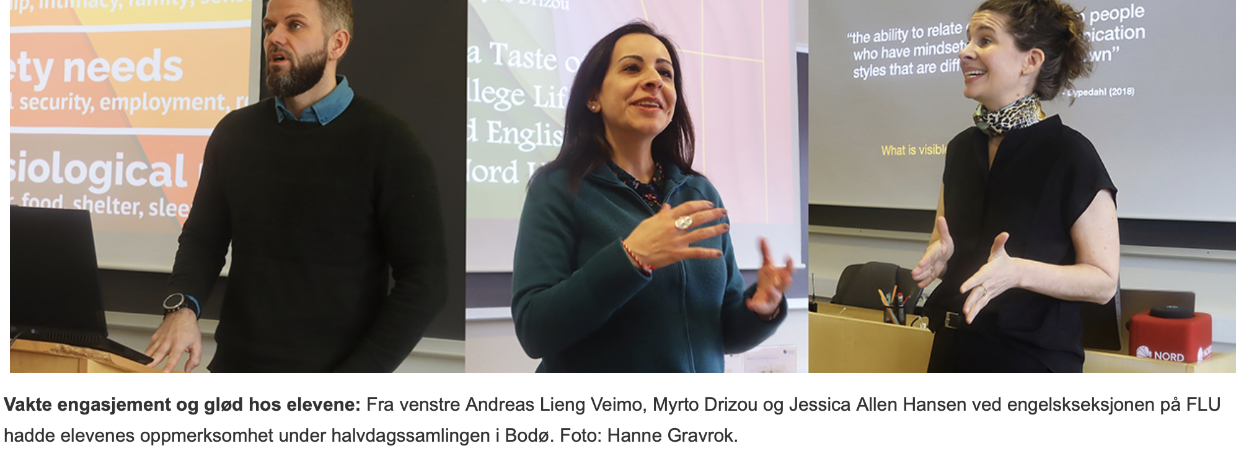
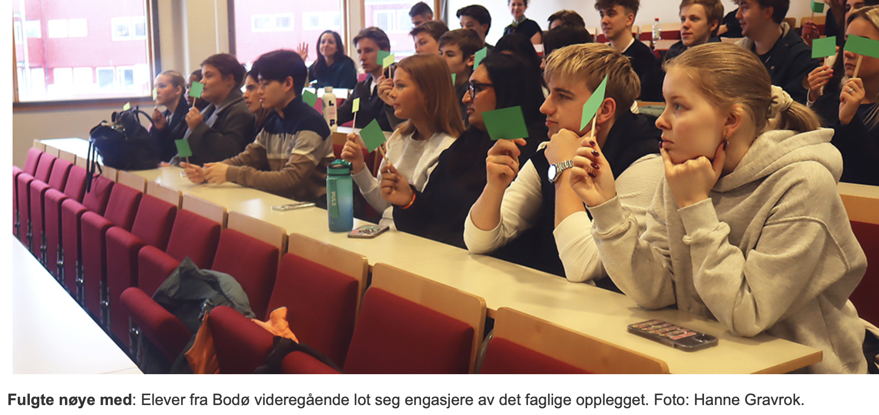
International Student and Academic Staff Exchange
SEA-EU
Catalogue
COIL
Erasmus+ KA2 applications
Visiting scholars …
https://youtu.be/nPDg5PFjTaY

