Slide 1

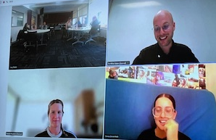

Collage Across Borders
  A COIL Partnership between Northumbria University
  and Karel de Grote University College

Slide 2
Project Rationale
Experiences
Workshop

Slide 3
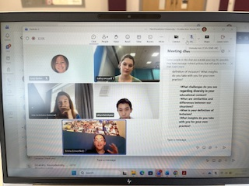
Rethinking Reflection in Teacher Education
Reflection practices assume strong language proficiency
Not all students have equal access to academic language
Particularly challenging for:
  multilingual students
  in-service trainees
  career changers
→ Risk of excluding valuable perspectives
Notes:
Reflection is a core component of teacher education, yet it is often approached through language-heavy formats such as written reports or verbal discussions. In diverse urban contexts, we observe that students often lack the linguistic resources to express complex pedagogical experiences, resulting in rather superficial reflections.
Traditional reflection formats privilege students who are verbally strong. This creates inequities, especially for multilingual learners or students returning to education. As a result, important experiential knowledge often remains unexpressed.

Slide 4
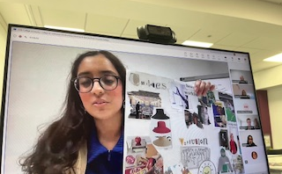
Expanding Reflection Beyond Language
Arts based method
A Northumbria student shares her collage and ideas
Need for multimodal reflection practices
Reflection as meaning-making, not only reporting
Arts-based methods enable:
  metaphorical thinking
  associative reasoning
  embodied knowledge
Notes:
We position reflection not merely as reporting, but as meaning-making. Arts-based approaches, such as collage, allow students to work with images, metaphors, and composition, enabling deeper and more nuanced forms of reflection.

Slide 5
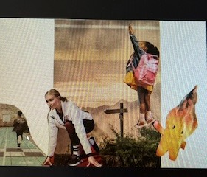
Beyond Words: Collage as Inclusive Pedagogy (UDL)
Collage aligns with Universal Design for Learning (UDL):
  Multiple means of representation (visual, symbolic)
  Multiple means of expression (beyond writing/speaking)
  Multiple means of engagement (creative, low-stakes)
Images communicate where words fall short:
  expression of tacit knowledge
  shared interpretation
  cross-linguistic understanding
Particularly valuable in international settings
Notes:
Collage fits strongly within UDL principles. It expands how students access, process, and express knowledge. It lowers barriers and increases engagement by allowing personal and creative entry points.
Visual language allows students to communicate ideas that are difficult to articulate verbally. In international collaboration, this becomes even more powerful, as images can bridge linguistic differences.

Slide 6

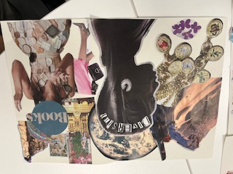
COIL as an Inclusive Approach
Traditional mobility is not accessible to all students:
Financial
Personal
Professional (in-service students)
Need for alternatives: Collaborative Online International Learning (COIL)
international exchange without travel
low-threshold participation
integration into existing curricula
Creates authentic intercultural dialogue
Notes:
International experiences are valuable, but not equally accessible. Many students cannot participate in mobility programs due to various constraints. This raises questions about equity in internationalisation.
COIL offers a scalable and inclusive alternative to physical mobility. It allows students to engage in meaningful international dialogue within their own learning environment.

Slide 7
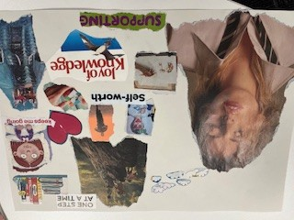
Project Rationale
Combine:
collage as inquiry (arts-based reflection)
COIL (inclusive internationalisation)
Goal:
deepen reflection topic Special Educational Needs
broaden expression
enable intercultural exchange
Notes:
This project brings together two powerful approaches: collage as a reflective method and COIL as an international framework. Together, they aim to create a richer, more inclusive learning experience.

Slide 8
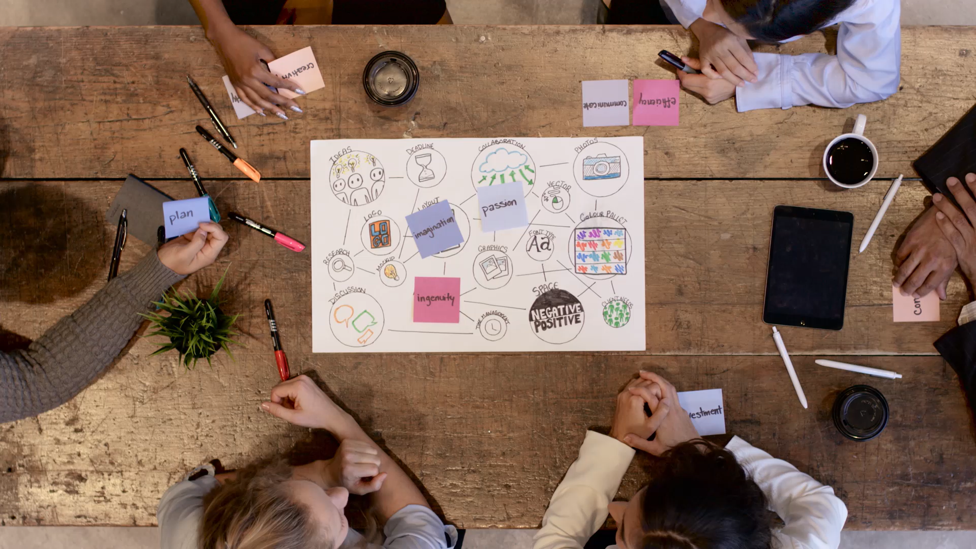
Educational Design Framework
COIL-based learning design
Dialogic, student-centred approach
Focus on inclusion and meaning-making
Data for Arts-Based Educational Research (ABER)
Key Design Principles
Multimodal reflection (collage)
Small-group interaction (international mix)
Low-stakes environment
Focus on inclusive pedagogy
Notes:
The project is grounded in a COIL framework and informed by arts-based educational research. It emphasizes dialogue, student agency, and inclusive meaning-making.

Slide 9
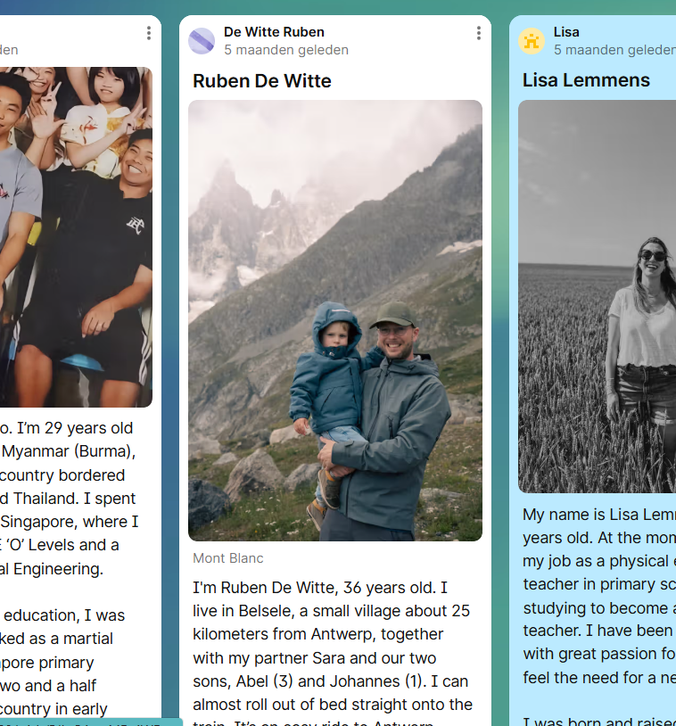
Creating Psychological Safety
Icebreaker via Padlet
Students placed with at least one familiar peer
Clear structure and expectations
Optional guiding questions beforehand
Teacher as facilitator
Notes:
Psychological safety was intentionally designed. Familiarity, structure, and support reduced anxiety, especially in an international setting.
Students were not left alone in the process. Scaffolding ensured depth in discussion and supported students who might otherwise remain silent.

Slide 10
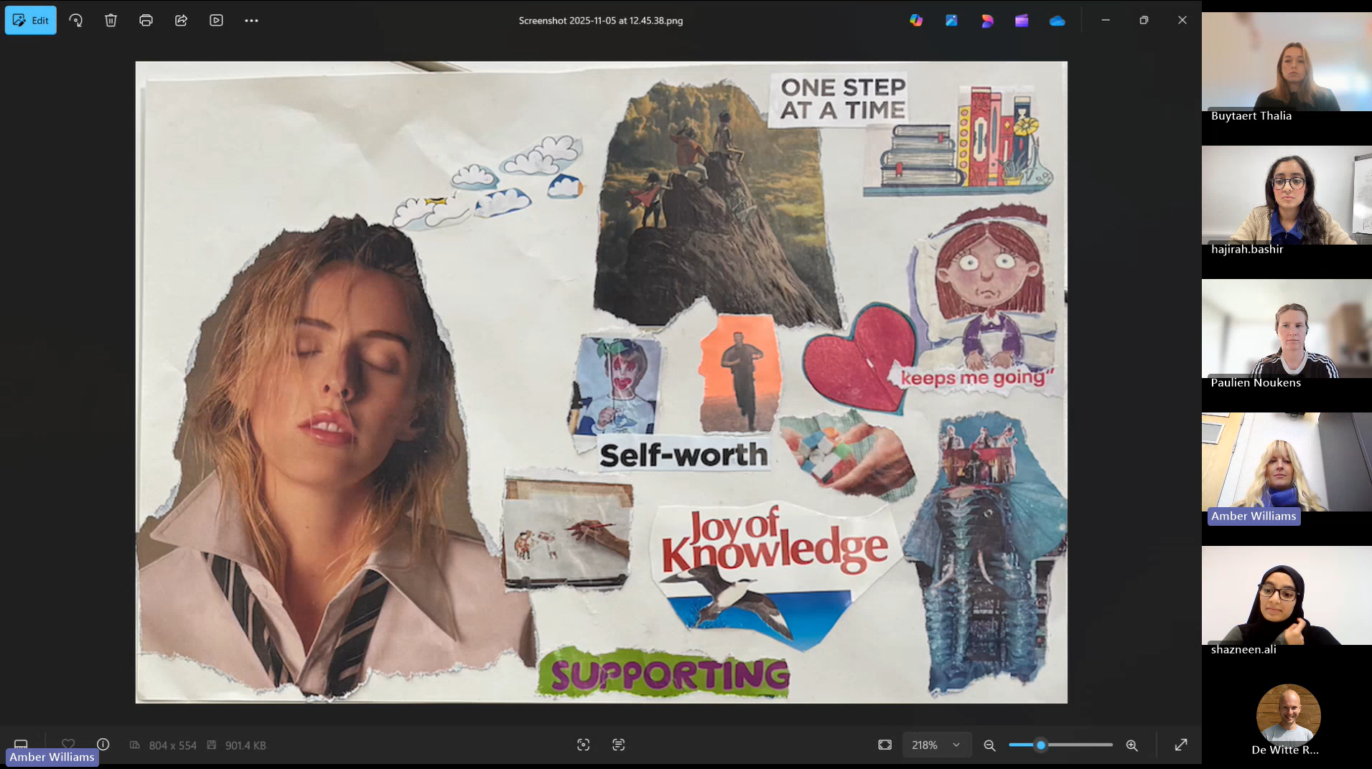
Setup
Preparation
Collage Creation
Live COIL Session
Poetic Reflection
“How do you, as a teacher, make a difference for all pupils?”
Notes:
Preparation
Padlet introductions Students share: identity, context & interests
Goal: build connection before collaboration
Collage Creation
Use images, metaphors, composition
Live COIL Session
90-minute online session (MS Teams)
Plenary introduction
Breakout rooms (4 students)
Presentation + dialogue
Poetic Reflection
Transcribe conversation
Select key phrases
Transform into a poem
Capture essence of dialogue

Slide 11
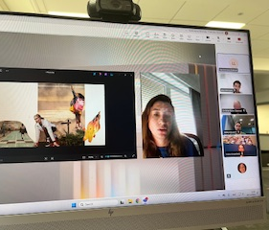
Student Experience: Visual Language as a Bridge
Students experienced collage as a low-stakes way into complex ideas
The visual format reduced pressure to speak “perfect” English or give the “right” answer
The activity invited more creative and personal engagement with inclusion
Students were able to make meaning across minor language differences
The method invited interpretation, reflection, and poetic expression
This suggests that arts-based methods can deepen reflective engagement with diversity and inclusion
Notes:
Students described the collage task as an accessible and low-pressure way to engage with the topic of inclusion. Rather than experiencing reflection as a performance, they could enter the conversation through images, metaphors, and associations. This created a more open and relaxed space for participation.
One of the strongest findings was that the visual medium helped bridge what spoken or written language sometimes cannot. Students could interpret and respond to each other’s collages through shared visual references, which made the exchange more inclusive and meaningful.
The student experience shows a shift from reporting to meaning-making. Instead of giving formulaic answers, students created responses with depth, metaphor, and emotional force. This illustrates the value of arts-based inquiry for teacher education, especially when working on themes such as diversity and inclusion.

Slide 12
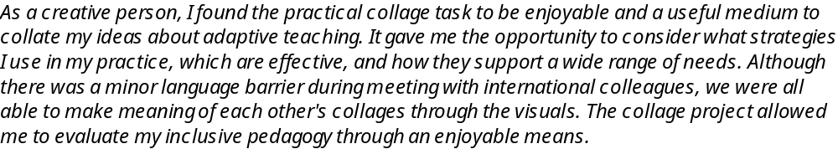
Student response:
Bailey:

Slide 13
Students encountered different perspectives on inclusion across cultural and educational contexts
Students discovered that ideas of inclusive practice resonated across different systems
Diversity was experienced as a resource for dialogue rather than as a barrier
This strengthened students’ sense of connection across borders
Students developed a stronger sense that inclusive practice is a shared educational value
Student Experience: Shared Values Across Borders
Notes:
A key outcome was that students did not simply talk about diversity in the abstract. They encountered it through the perspectives of peers from another context. This helped build openness, recognition, and a more positive attitude towards difference. Diversity became something to learn from, rather than something to overcome.

Slide 14

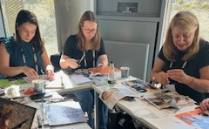
Collages – now your turn!
Transition to Workshop
Workshop Instructions
Workshop Reflection and Debrief
Browse the magazines
Let your hands and the scissors do the talking!

Slide 15
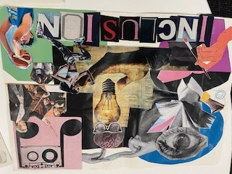
If you are interested in joining our project please get in touch:
Lucy; l.a.barker@northumbria.ac.uk
Further reading about our collage project:
JETEN collage across borders

