Slide 1
Designing a Moodle-Based Vocabulary Course for Young L2 Learners
Presented at the ETEN Conference, Tirana, Albania, April 2026.
Faris Keblawi, Al-Qasemi Academy
Iman Keblawi, Tel-Aviv University

Slide 2
Why vocabulary growth matters
Vocabulary growth is central to language learning progress.
Vocabulary knowledge is strongly associated with performance in other language skills.
Young L2 learners need systematic (planned) vocabulary development: what words to teach, why, when, and how.
Vocabulary learning should support both breadth and depth of word knowledge.

Slide 3
Purpose of the study and research questions
To investigate the effectiveness of a Moodle-based vocabulary course for Grades 3–6 that supports vocabulary development through a self-regulated learning approach.
Research Questions
  To what extent does participation in the course improve learners’ vocabulary knowledge?
  How does the course design support the development and use of self-regulated learning strategies?

Slide 4
Why SRL matters for young learners?
Classes often include learners with very different levels.
Young learners also need support to become more independent vocabulary learners: in planning, monitoring, and reflecting on their learning.
SRL can help them manage their effort, track progress, and stay motivated.

Slide 5
Self-regulated learning and vocabulary growth
Planning (setting goals and plans)
  pre-tests at grade and theme levels
  clear course structure
  clear goals
Monitoring: (monitoring progress and work)
  immediate feedback
  progress indicators
  mastery threshold
Reflection: (assessing quality of work / progress)
  post-theme self-evaluation
  engagement surveys

Slide 6
The vocabulary course design
Based on the official Ministry vocabulary list
Includes about 1,400 words
Organized by grade level
Divided into themes and sub-themes for contextual relevance
Includes about 15 target words per sub-theme

Slide 7
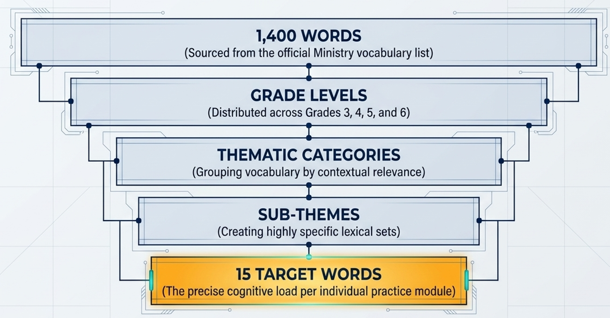
A systematic approach to vocabulary teaching

Slide 8
Task Types
Formats: multiple-choice and short-answer items
Task types:
  word definitions
    matching words to images
    word completion
    sentence completion
    odd-one-out

Slide 9
Progress so far
Developed the course content and exercises
Uploaded materials to Moodle
Reviewed the content with teachers and students
Prepared SRL guidelines for students and teachers
Prepared vocabulary learning and teaching guidelines for students and teachers
Began developing the research plan, which is currently being substantially revised

Slide 10
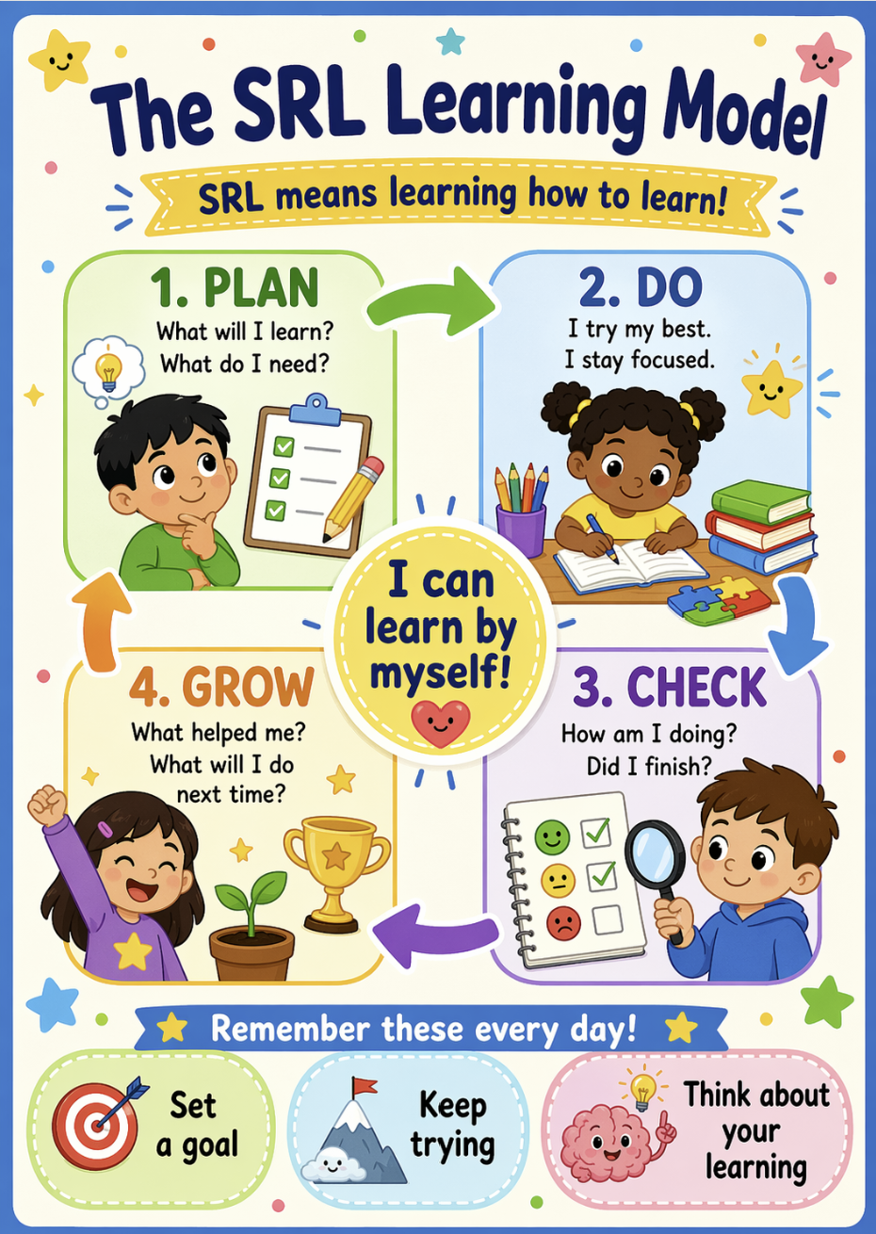
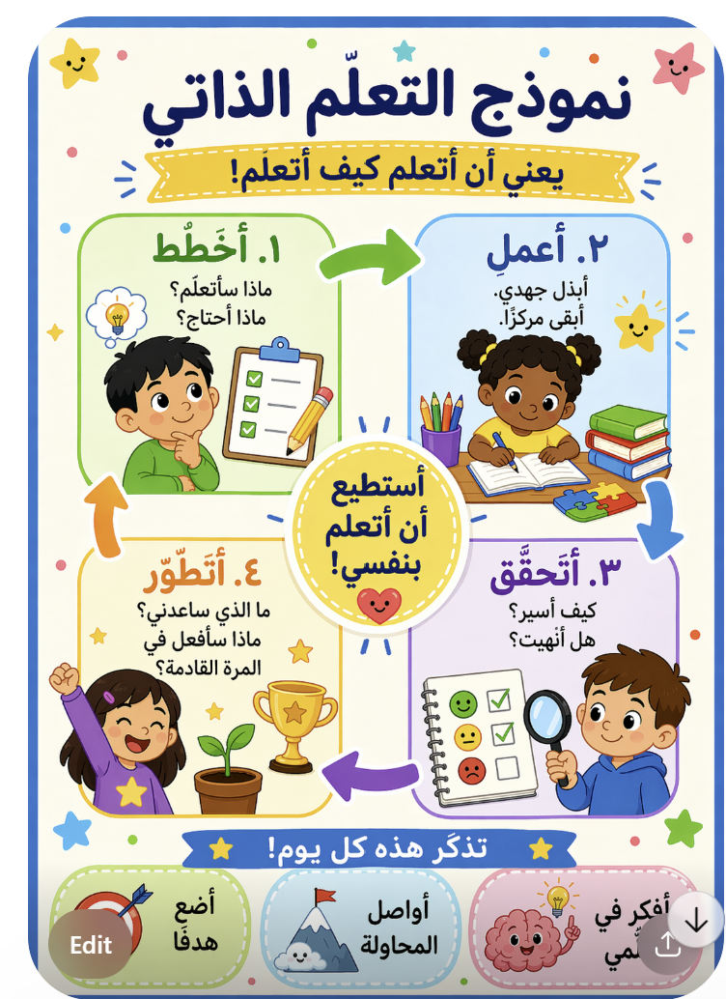
Sample guidelines for students (1)

Slide 11
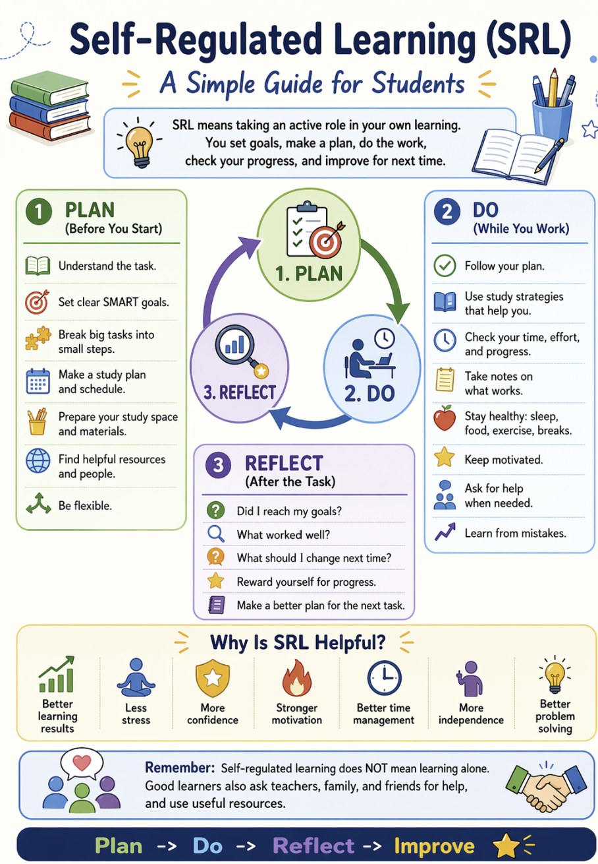
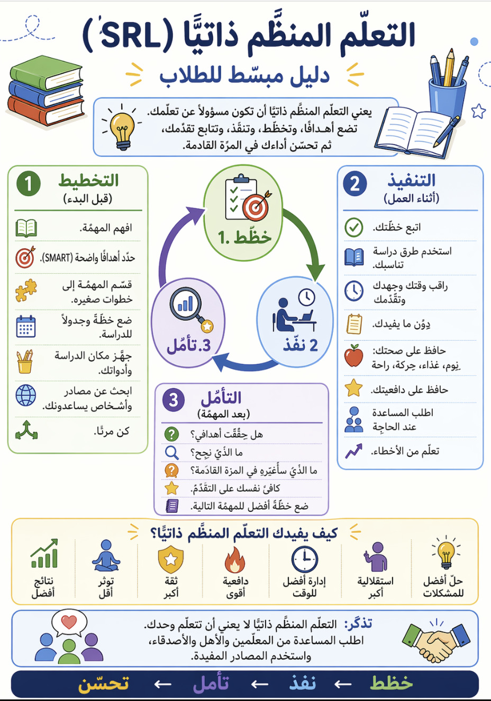
Sample guidelines for students (2) (older)

Slide 12
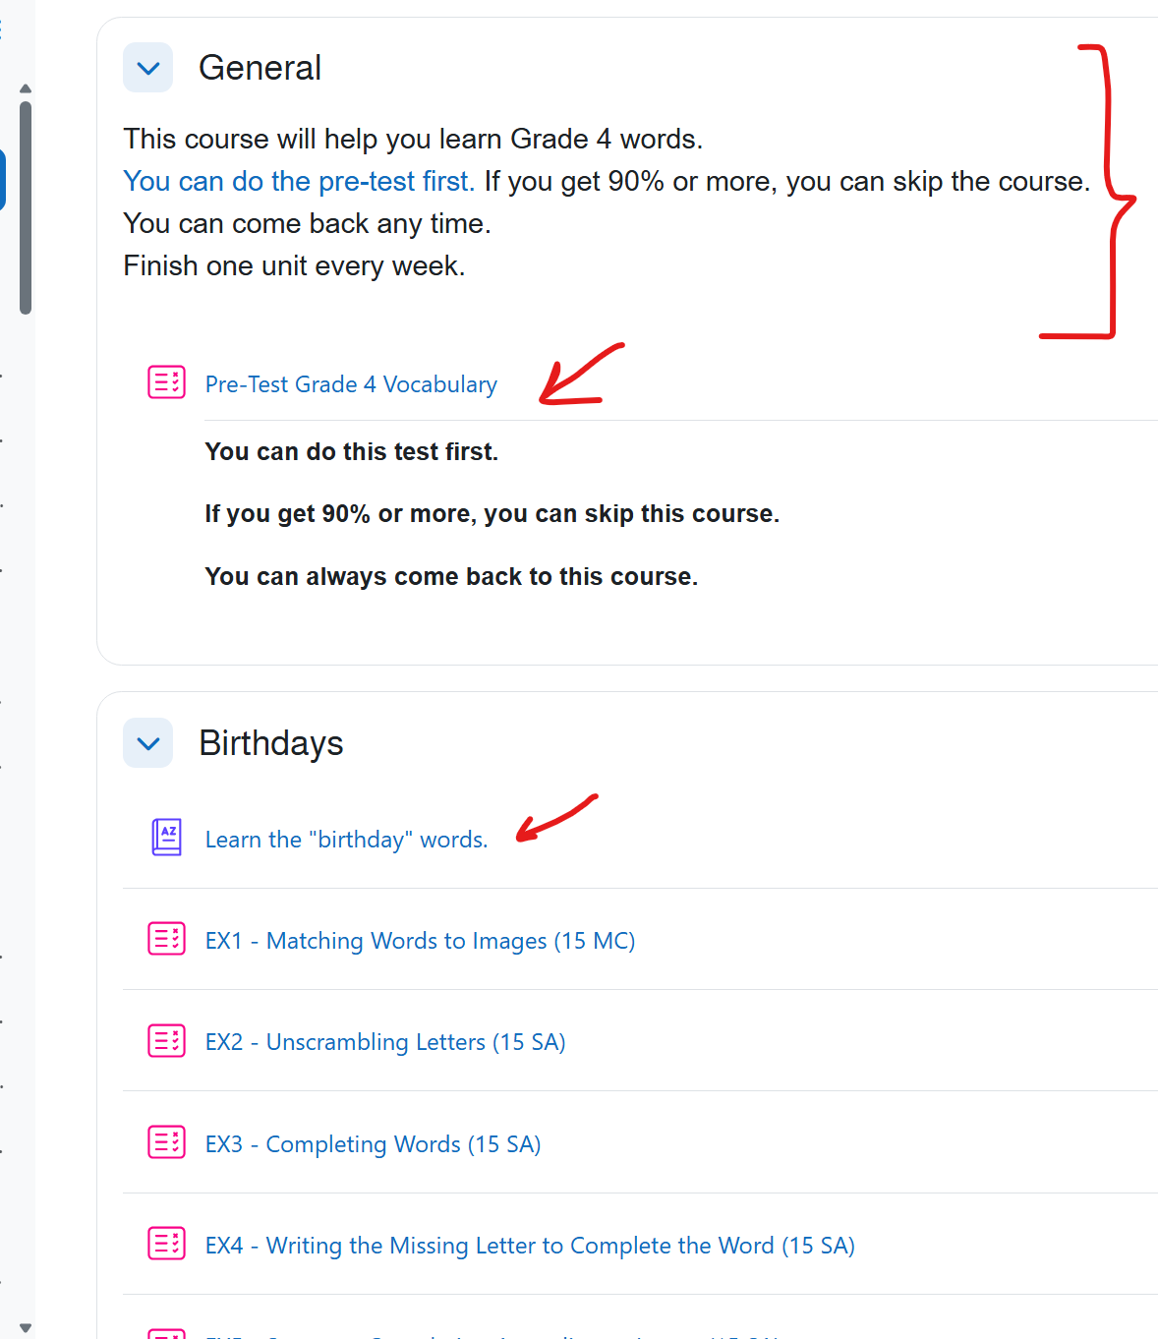
Sample course and theme design:
Purpose
Pre test
Tutorials

Slide 13
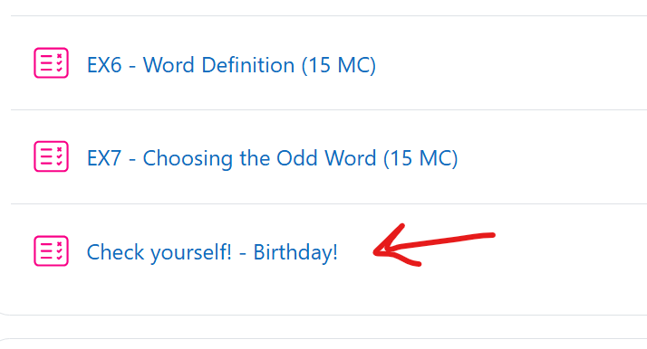
Checking progress

Slide 14
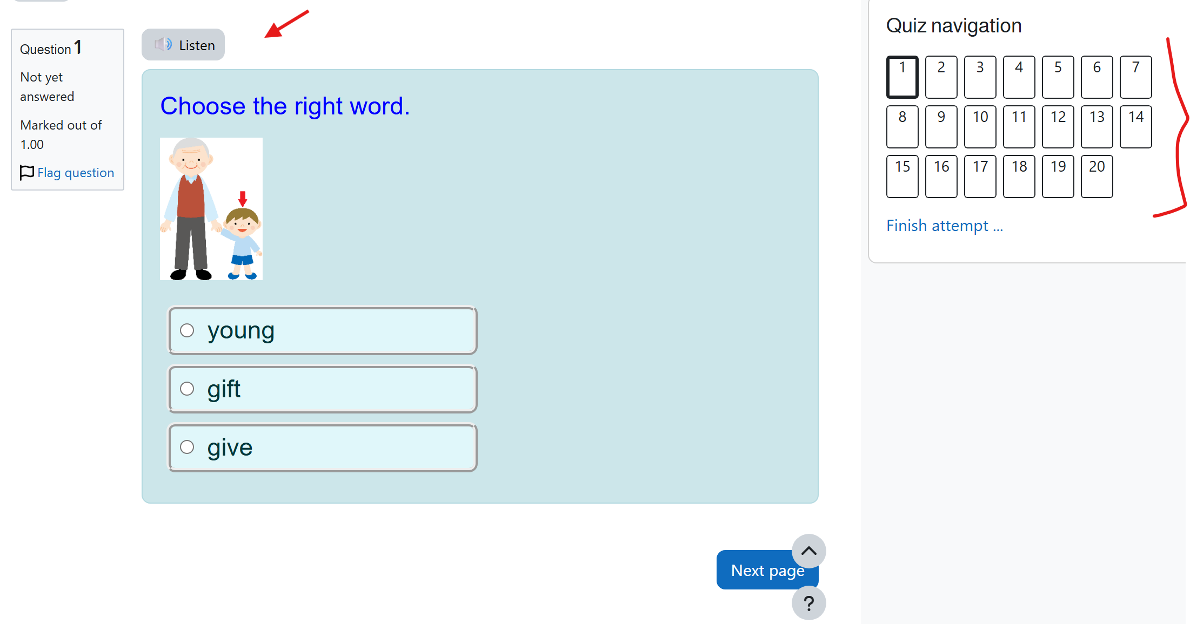
Sample exercise

Slide 15
Expected contribution
Offers a structured digital vocabulary-learning model for young learners
Combines mastery learning with SRL support
May help teachers address learner differences more effectively
May provide insight into how young learners engage with independent digital vocabulary learning

Slide 16
Thank You!

