Slide 1
ETEN 2027
April 7-9 in Lund
Notes:
Good morning everyone, my name is Emil Bernmalm, the ECO of Lund university. With me here I have my esteemed colleques pro
First of all , we would like to thank Eva Cipi and her team for the lovely experience here in Vlora!
At Lund Univeristy we are very happy to be hosting the next ETEN symposium in the Spring 2027

Slide 2
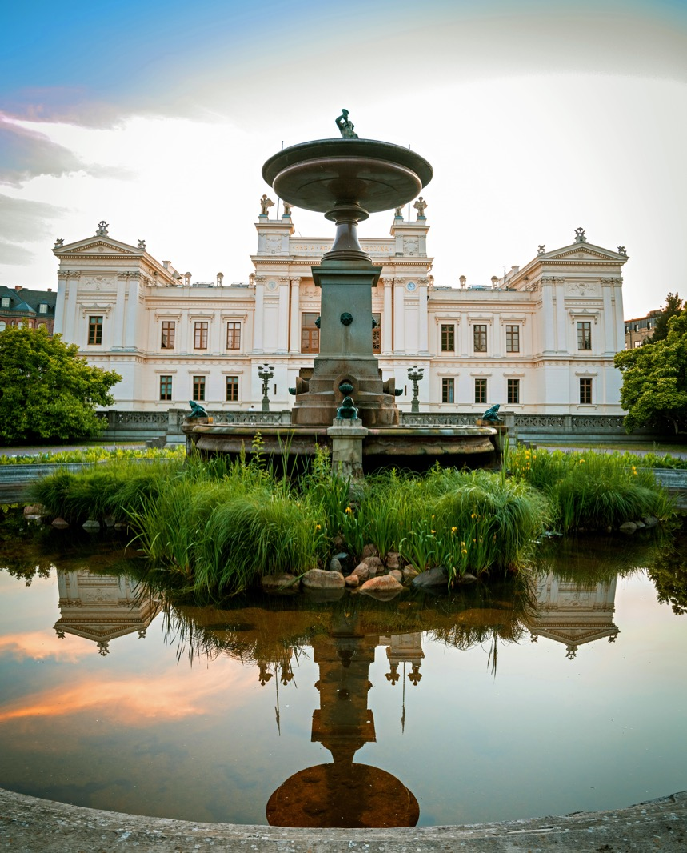

Where?
Lund University, Sweden
EDUCATION, RESEARCH AND COLLABORATION SINCE 1666
Notes:
Introductions…
First, we would like to thank XXX for the lovely and educative experience here in Vlora!
At Lund Univeristy we are very happy to be hosting the next ETEN symposium in the Spring 2027
Founded in 1666 and located in the southern part of Sweden, LU is one of one of the largest universities in Sweden, with around 46,000 students, and a strong research focus.
The university is organized into nine faculties, and the Department of Educational Sciences, founded in 2011, plays an important role in teacher education and research.
At Lund University, we focus on preparing teachers for secondary and upper secondary education, addressing the specific demands of teaching older students.

Slide 3
Teacher Education at Lund University
A small teacher education founded in 2011 (about 160 new students/year)
Many departments at the university contribute to teacher education
Strong subject identity
Low degree of integration between different parts of the programme
Notes:
The department of Educational Sciences is a small and young institution at Lund university. Teacher education is a heterogenous organisation consisting of many departments and with a strong subject identity.

Slide 4



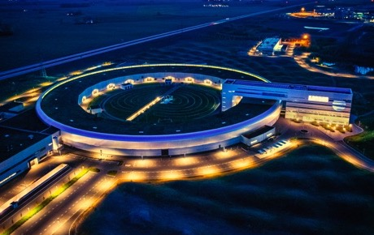
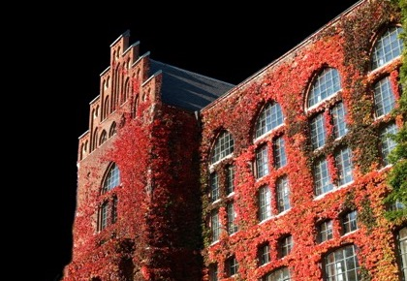

Lund University
One of the world’s top 100 universities – No. 72 in the QS World University Rankings 2026
World leader in sustainability – No. 1 in the QS World University Rankings: Sustainability 2026
Best in the Nordic region – and no. 12 i Europe in the QS World University Rankings: Europe 2026
9 faculties
4 campuses
46 000 students
8 500 staff
1 516 freestanding courses
265 study programmes
1 Nobel Prize
2 700 doctoral students
EUR 1024 million
in turnover
Notes:
Lund University is a broad, research-intensive university. Its research areas span from Natural sciences, engineering and medicine to humanities and theology. LU is ranked among the top 100 universities in the world, and we are off course extra pound of being world leader in sustainability.

Slide 5
Why?
Visit schools and educational institutions in Lund/Malmö
Promote opportunities for exchange and/or visits for teacher education students
Meet students and teachers in Sweden
Take part of practice-research educational collaboration to enhance teachers’ professional development and students’ learning
Meet one of our teacher educators – our Nobel Prize winner Anne L’Huillier

Slide 6
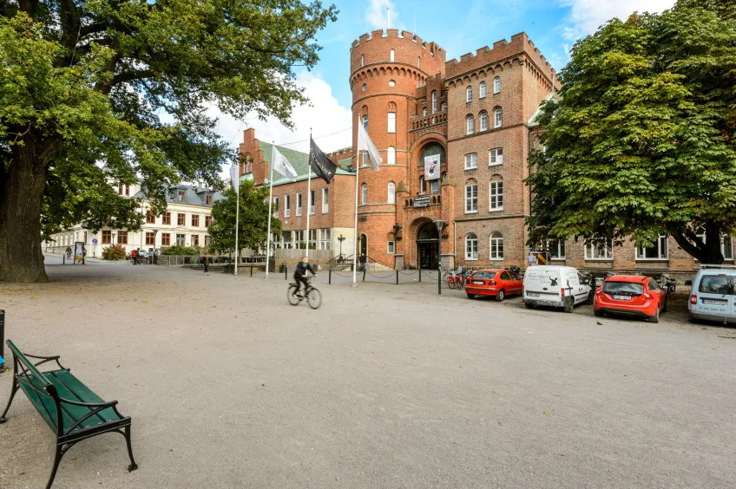
When?
ERASMUS-applicants’ workshops at Monday the 5th and Tuesday the 6th of April at the Department of Educational Sciences or Humanities lab
ECO and TIC leaders meeting Wednesday 7th of April
ETEN 2027 starts at 16 o’clock Wednesday 7th of April at the Academic Society in Lundagård (in the central of Lund)
Social tours Saturday at the 10th of April

Slide 7
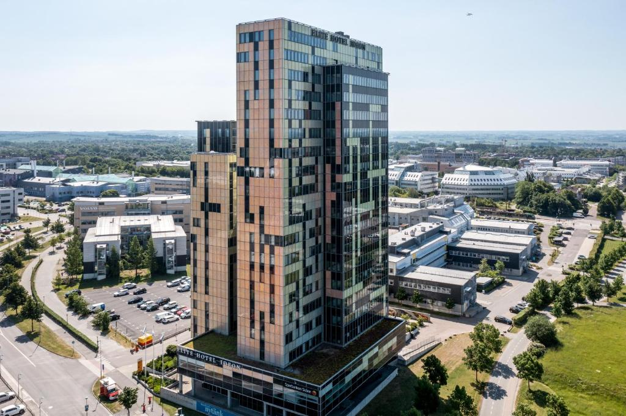
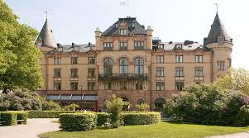

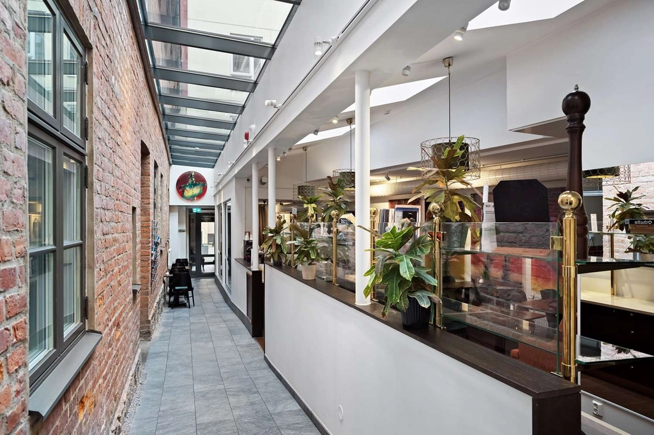

Hotels

Slide 8
How?
By air – Copenhagen Airport and train to Lund (39 minutes)
By air - Malmö Airport and airport Coaches to Malmö C (40 min) and then train to Lund (15 minutes)
By train – SJ Euronight via Copenhagen, DB etc.

Slide 9
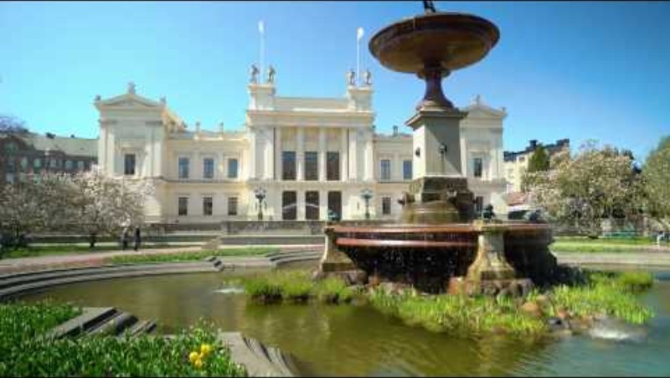

Slide 10

End slide. Logotype only.

